Slide 1
inventory management system
Group No: 17
Roll No | Name
31 | Kashyap Ashara
35 | Kishan Kewalramani
74 | Amit Thakkar

Slide 2
Scope And Definition
AHMEDABAD UNIVERSITY SCHOOL OF COMPUTER STUDIES(BCA Programme)
Scope:-
To computerize the inventory management system including the details of sales, purchase , products , customers and suppliers so the relationship between the company with supplier and customer can be maintain properly

Slide 3
Scope And Definition
AHMEDABAD UNIVERSITY SCHOOL OF COMPUTER STUDIES(BCA Programme)
Definition:-
Inventory Management System plays a critical role for any manufacturing Company or Firm. The system mainly focuses on management of Inventory of Meet Garments also it includes a better way to manage inventory transactions in order to facilitate good relationship between customer and supplier.

Slide 4
System Requirement
AHMEDABAD UNIVERSITY SCHOOL OF COMPUTER STUDIES(BCA Programme)
Hardware Requirements
Processor : Pentium IV 2GHz and Above
RAM : 128Mb RAM
Monitor : Color Monitor
Keyboard
Mouse

Slide 5
System Requirement
AHMEDABAD UNIVERSITY SCHOOL OF COMPUTER STUDIES(BCA Programme)
Software Requirements
Operating System : Windows XP,7,8
Developing Tool : Visual Basic 8.0
Database : MS Access 2007-13
NET Framework 3.5 or above
Access Database Engine( 32 bit-64 bit)

Slide 6
Data Flow Diagram
AHMEDABAD UNIVERSITY SCHOOL OF COMPUTER STUDIES(BCA Programme)

Slide 7
Context Level
AHMEDABAD UNIVERSITY SCHOOL OF COMPUTER STUDIES(BCA Programme)

Slide 8
Zero Level
AHMEDABAD UNIVERSITY SCHOOL OF COMPUTER STUDIES(BCA Programme)

Slide 9
First Level 1.0
AHMEDABAD UNIVERSITY SCHOOL OF COMPUTER STUDIES(BCA Programme)

Slide 10
First Level 2.0
AHMEDABAD UNIVERSITY SCHOOL OF COMPUTER STUDIES(BCA Programme)

Slide 11
First Level 3.0
AHMEDABAD UNIVERSITY SCHOOL OF COMPUTER STUDIES(BCA Programme)

Slide 12
Second Level 1.0
AHMEDABAD UNIVERSITY SCHOOL OF COMPUTER STUDIES(BCA Programme)

Slide 13
Second Level 2.0
AHMEDABAD UNIVERSITY SCHOOL OF COMPUTER STUDIES(BCA Programme)

Slide 14
Second Level 3.0
AHMEDABAD UNIVERSITY SCHOOL OF COMPUTER STUDIES(BCA Programme)

Slide 15
Entity Relationship Diagram
AHMEDABAD UNIVERSITY SCHOOL OF COMPUTER STUDIES(BCA Programme)

Slide 16
Entity Relationship Diagram
AHMEDABAD UNIVERSITY SCHOOL OF COMPUTER STUDIES(BCA Programme)

Slide 17
Data Dictionary
AHMEDABAD UNIVERSITY SCHOOL OF COMPUTER STUDIES(BCA Programme)

Slide 18
Data Dictionary
AHMEDABAD UNIVERSITY SCHOOL OF COMPUTER STUDIES(BCA Programme)
Tables Name : Login
Table Description : Contain Information of login details
Field Name | Data Type | Constraints | If Fk, referenced from | Description
Username | Varchar(30) | Primary key |  | Login username
Password | Varchar(15) | Not null |  | Login password

Slide 19
Data Dictionary
AHMEDABAD UNIVERSITY SCHOOL OF COMPUTER STUDIES(BCA Programme)
Table name: Customer_details
Table Description: Contain Information of customer details
Field Name | Data Type | Constraints | If Fk, referenced from | Description
Customer_id | Varchar(5) | Primary key |  | Customer id
Customer_name | Varchar(30) | Not null |  | Customer name
Address | Varchar(200) | Not null |  | Customer address
City_id | Varchar(5) | Foreign key | City | City_id
Pincode | Numeric(10,0) | Not null |  | Customer city pincode
Contact | Numeric(15,0) | Not null |  | Customer number
Email | Varchar(50) |  |  | Customer email id
CST | Numeric |  |  | common sales tax no

Slide 20
Data Dictionary
AHMEDABAD UNIVERSITY SCHOOL OF COMPUTER STUDIES(BCA Programme)
Table name: Supplier_details
Table Description: Contain Information of supplier details
Field Name | Data Type | Constraints | If Fk, referenced from | Description
Supplier_id | Varchar(5) | Primary key |  | Supplier id
Supplier_name | Varchar(30) | Not null |  | Supplier name
Address | Varchar(200) | Not null |  | Supplier address
City_id | Varchar(5) | Not null | Foreign key | City_id
Pincode | Numeric(10,0) | Not null |  | Supplier city pincode
Contact | Numeric(15,0) | Not null |  | Supplier number
Email | Varchar(50) |  |  | Supplier email id
Cst | Numeric |  |  | common sales tax no

Slide 21
Data Dictionary
AHMEDABAD UNIVERSITY SCHOOL OF COMPUTER STUDIES(BCA Programme)
Table name: Sales_item_details
Table Description: Contain Information of sales item details
Field Name | Data Type | Constraints | If Fk, referenced from | Description
Sales_Item_id | Varchar(5) | Foreign key | Item_details | sales item id
Item_name | Varchar(20) | Not null |  | item name
Item_price | Numeric(10,2) | Not null |  | item price
Item_remain_qty | Numeric(10,0) | Not null |  | item remaing qty

Slide 22
Data Dictionary
AHMEDABAD UNIVERSITY SCHOOL OF COMPUTER STUDIES(BCA Programme)
Table name: Purchase_item_details
Table Description: Contain Information of purchase item details
Field Name | Data Type | Constraints | If Fk, referenced from | Description
item_id | Varchar(5) | Primary key |  | Item id
Item_name | Varhcar(20) | Not null |  | Item name
Item_price | Varchar(10,2) | Not null |  | item price
Item_qty | Numeric(10,0) | Not null |  | Item quantity

Slide 23
Data Dictionary
AHMEDABAD UNIVERSITY SCHOOL OF COMPUTER STUDIES(BCA Programme)
Table name: Purchase
Table Description: Contain Information of purchase details
Field Name | Data Type | Constraints | If Fk, referenced from | Description
Purchase_id | Varchar(5) | Primary key |  | Purchase id
Supplier_id | Varhcar(5) | Foreign key | Supplier table | Supplier if from supplier table
Pur_date | Datetime | Not null |  | Date of purchase
Amount | Numeric(10,2) | Not null |  | Amount of purchase

Slide 24
Data Dictionary
AHMEDABAD UNIVERSITY SCHOOL OF COMPUTER STUDIES(BCA Programme)
Table name: Purchase_details
Table Description: Contain Information of purchase details details
Field Name | Data Type | Constraints | If Fk, referenced from | Description
purchase_id | Varchar(5) | Primary key |  | purchase id
Item_id | Varhcar(5) | Foreign key | item table | item id
Qty | Datetime | Not null |  | quantity
Rate | Numeric(10,2) | Not null |  | price
Amount | Numeric(10,2) | Not null |  | amount

Slide 25
Data Dictionary
AHMEDABAD UNIVERSITY SCHOOL OF COMPUTER STUDIES(BCA Programme)
Table name: Purchase_return
Table Description: Contain Information of purchase return details
Field Name | Data Type | Constraints | If Fk, referenced from | Description
Purc_ret_id | Varchar(5) | Not null |  | Id of purchase returns
Purchase_id | Varchar(5) | Foreign key | Purchase table | Id of purchase from purchase table
Pur_return_date | Datetime | Not null |  | Purchase returns date
Total | Numeric(10,2) | Not null |  | total amt
Return_descr | Varchar(200) | Not null |  | Purchase return description

Slide 26
Data Dictionary
AHMEDABAD UNIVERSITY SCHOOL OF COMPUTER STUDIES(BCA Programme)
Table name: Purchase_return_details
Table Description: Contain Information of purchase return details
Field Name | Data Type | Constraints | If Fk, referenced from | Description
Return_id | Varchar(5) | Primary key |  | Id of purchase returns
Item_id | Varhcar(5) | Foreign key | item table | item id
Qty | Numeric(10,0) | Not null |  | quantity
Rate | Numeric(10,2) | Not null |  | rate
Amount | Numeric(10,2) | Not null |  | amount

Slide 27
Data Dictionary
AHMEDABAD UNIVERSITY SCHOOL OF COMPUTER STUDIES(BCA Programme)
Table name: Sales
Table Description: Contain Information of sales details
Field Name | Data Type | Constraints | If Fk, referenced from | Description
Sales_id | Varchar(5) | Primary key |  | sales id
Customer_id | Varhcar(5) | Foreign key | Customer table | Customer id from customer table
Sales_date | Datetime | Not null |  | Date of sales
Amount | Numeric(10,2) | Not null |  | Amount of sales

Slide 28
Data Dictionary
AHMEDABAD UNIVERSITY SCHOOL OF COMPUTER STUDIES(BCA Programme)
Table name: Sales_details
Table Description: Contain Information of sales details details
Field Name | Data Type | Constraints | If Fk, referenced from | Description
Sales_id | Varchar(5) | Primary key |  | sales id
Item_id | Varhcar(5) | Foreign key | item table | item id
Qty | Numeric(10,0) | Not null |  | quantity
Rate | Numeric(10,2) | Not null |  | rate
Amount | Numeric(10,2) | Not null |  | amount

Slide 29
Data Dictionary
AHMEDABAD UNIVERSITY SCHOOL OF COMPUTER STUDIES(BCA Programme)
Table name: Sales_return
Table Description: Contain Information of sales return details
Field Name | Data Type | Constraints | If Fk, referenced from | Description
Sales_ret_id | Varchar(5) | Not null |  | Id of sales returns
Sales_id | Varchar(5) | Foreign key | Sales table | Id of sales from sales table
sale_return_date | Datetime | Not null |  | sales returns date
Total | Numeric(10,2) | Not null |  | total
Return_descr | Varchar(200) | Not null |  | sales return description

Slide 30
Data Dictionary
AHMEDABAD UNIVERSITY SCHOOL OF COMPUTER STUDIES(BCA Programme)
Table name: Sales_return_details
Table Description: Contain Information of sales return details
Field Name | Data Type | Constraints | If Fk, referenced from | Description
Sales_id | Varchar(5) | Primary key |  | sales id
Item_id | Varhcar(5) | Foreign key | Customer table | Customer id from customer table
Qty | Numeric(10,0) | Not null |  | quantity
Rate | Numeric(10,2) | Not null |  | rate
Amount | Numeric(10,2) |  |  | amount

Slide 31
Data Dictionary
AHMEDABAD UNIVERSITY SCHOOL OF COMPUTER STUDIES(BCA Programme)
Table name: City
Table Description: Contain Information of city details
Field Name | Data Type | Constraints | If Fk, referenced from | Description
City_id | Varchar(5) | Primary key |  | City id
City_name | Varchar(20) | Not null |  | City Name

Slide 32
Data Dictionary
AHMEDABAD UNIVERSITY SCHOOL OF COMPUTER STUDIES(BCA Programme)
Table name: Order_master
Table Description: Contain Information of order master details
Field Name | Data Type | Constraints | If Fk, referenced from | Description
Order_id | Varchar(5) | Primary key |  | order id
Customer_id | Varchar(5) | Foreing key | customer table | customer id
Status | Varchar(20) | Not null |  | status
Date | Datetime | Not null |  | date

Slide 33
Data Dictionary
AHMEDABAD UNIVERSITY SCHOOL OF COMPUTER STUDIES(BCA Programme)
Table name: Order_details
Table Description: Contain Information of order details
Field Name | Data Type | Constraints | If Fk, referenced from | Description
Order_id | Varchar(5) | Primary key |  | order id
Item_id | Varchar(5) | Not null |  | item id
Qty | Numeric(10) | Not null |  | quantity

Slide 34
Validation and Verification Method
AHMEDABAD UNIVERSITY SCHOOL OF COMPUTER STUDIES(BCA Programme)
Customer Details: Id, Name, Address, contact details is required.
Supplier Details: Id, Name, Address, contact details is required.
Purchase Details: Id, Supplier details, date of order, product name, is required.
Sales Details: Id, Customer details, date of order, product name, is required.

Slide 35
Validation and Verification Method
AHMEDABAD UNIVERSITY SCHOOL OF COMPUTER STUDIES(BCA Programme)
Contact Details: Characters cannot be added in contact related fields. Mobile phone numbers cannot exceed 10 digits.
All the details coming from the parent tables cannot be edited.
Only owner can login into the system. (Change password is allowed)
Stock: Validation for the stock available is kept. If the stock is not available then proper messages is given.

Slide 36
Transaction Data Entry Screen
AHMEDABAD UNIVERSITY SCHOOL OF COMPUTER STUDIES(BCA Programme)

Slide 37
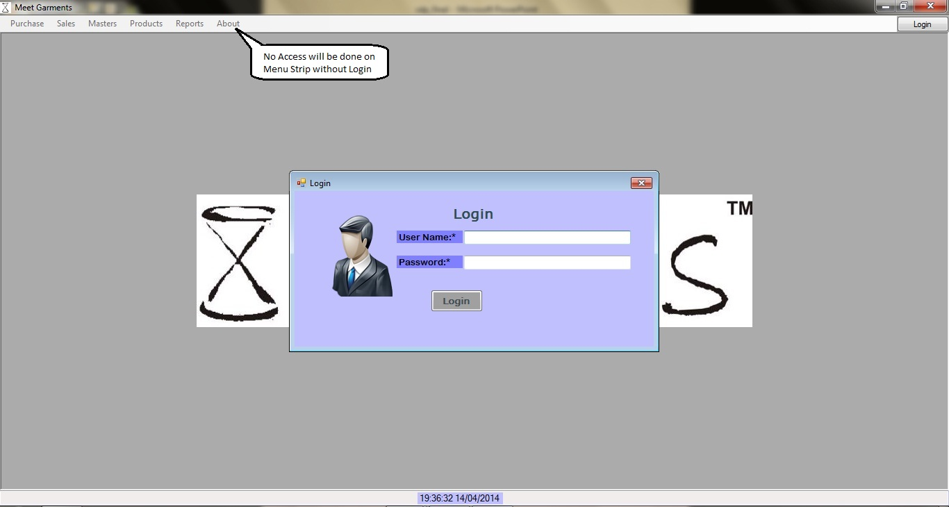
Login
AHMEDABAD UNIVERSITY SCHOOL OF COMPUTER STUDIES(BCA Programme)

Slide 38
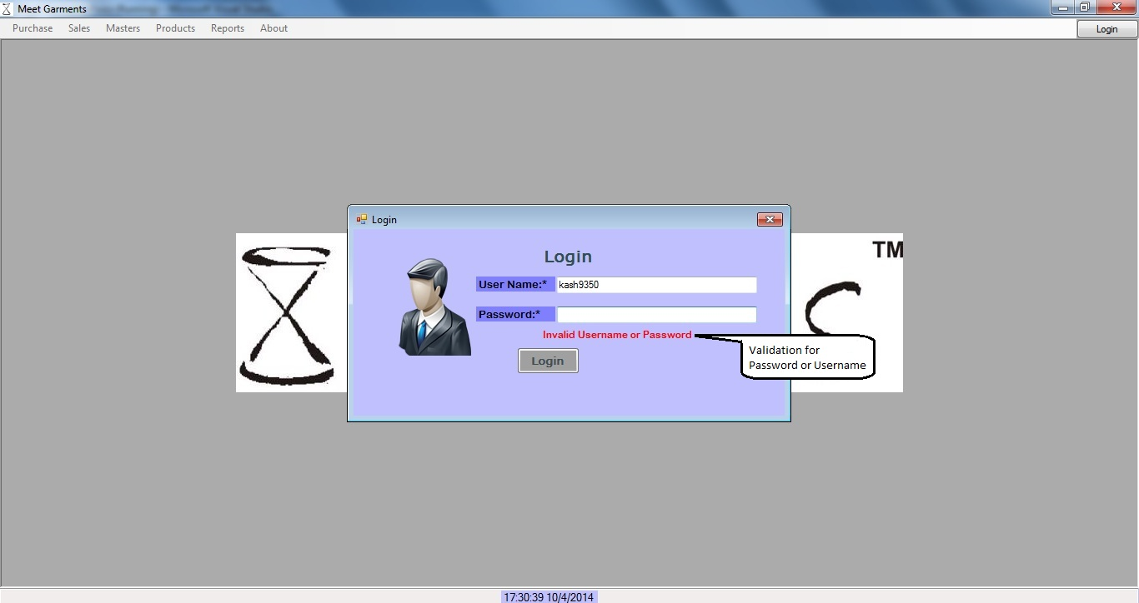
Login
AHMEDABAD UNIVERSITY SCHOOL OF COMPUTER STUDIES(BCA Programme)

Slide 39
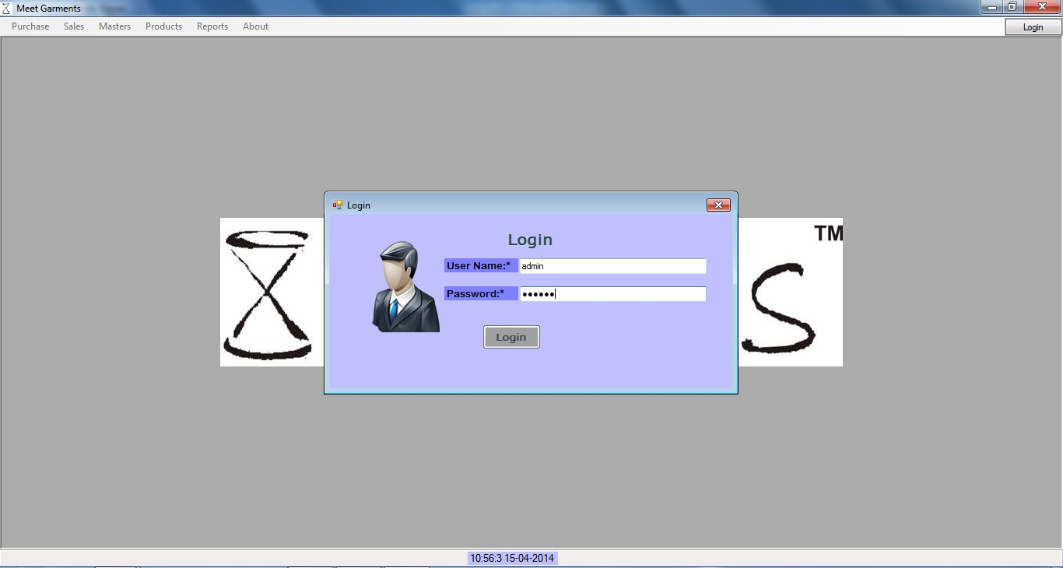
Login
AHMEDABAD UNIVERSITY SCHOOL OF COMPUTER STUDIES(BCA Programme)

Slide 40
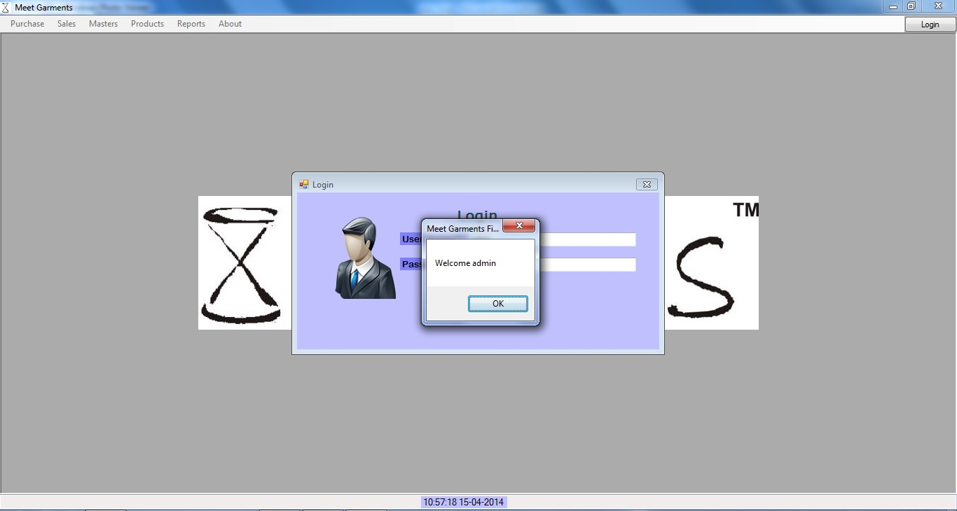
Login
AHMEDABAD UNIVERSITY SCHOOL OF COMPUTER STUDIES(BCA Programme)

Slide 41
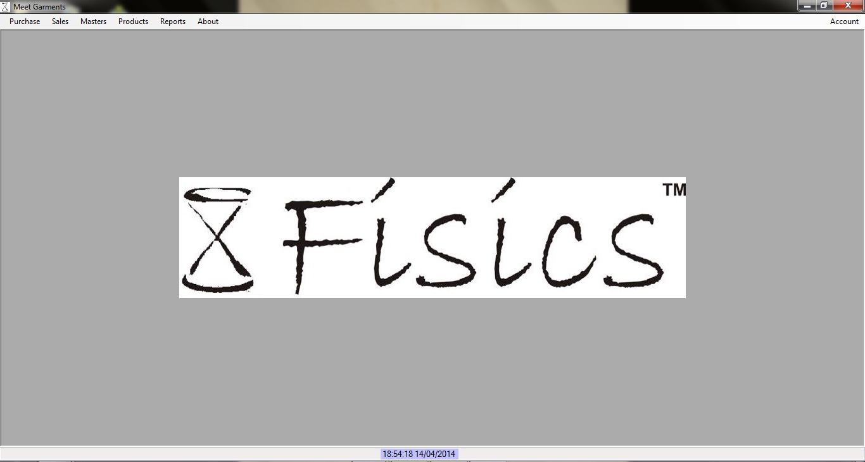
Login
AHMEDABAD UNIVERSITY SCHOOL OF COMPUTER STUDIES(BCA Programme)

Slide 42
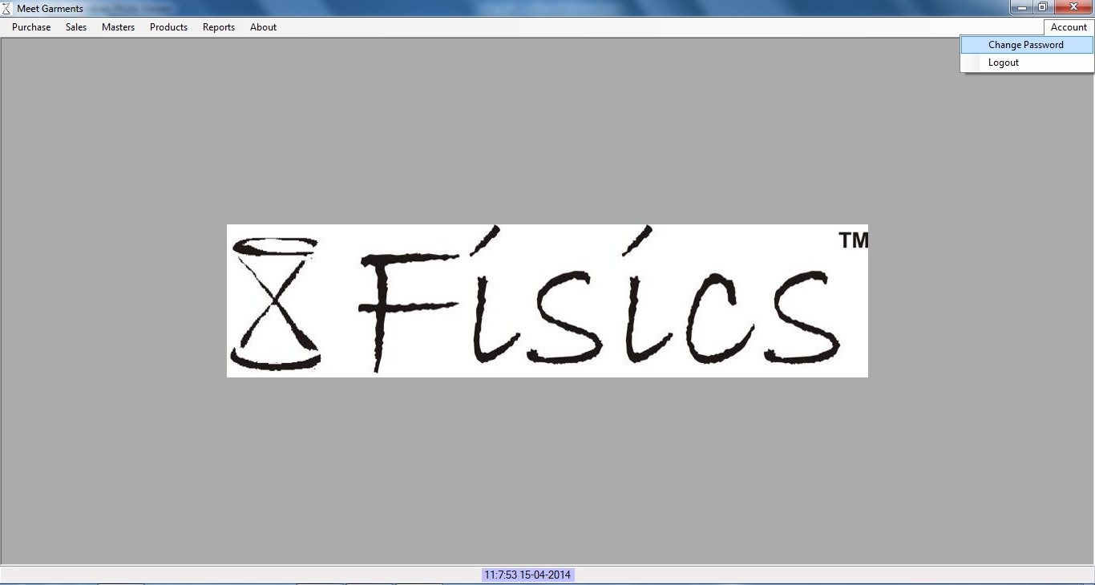
Login
AHMEDABAD UNIVERSITY SCHOOL OF COMPUTER STUDIES(BCA Programme)

Slide 43
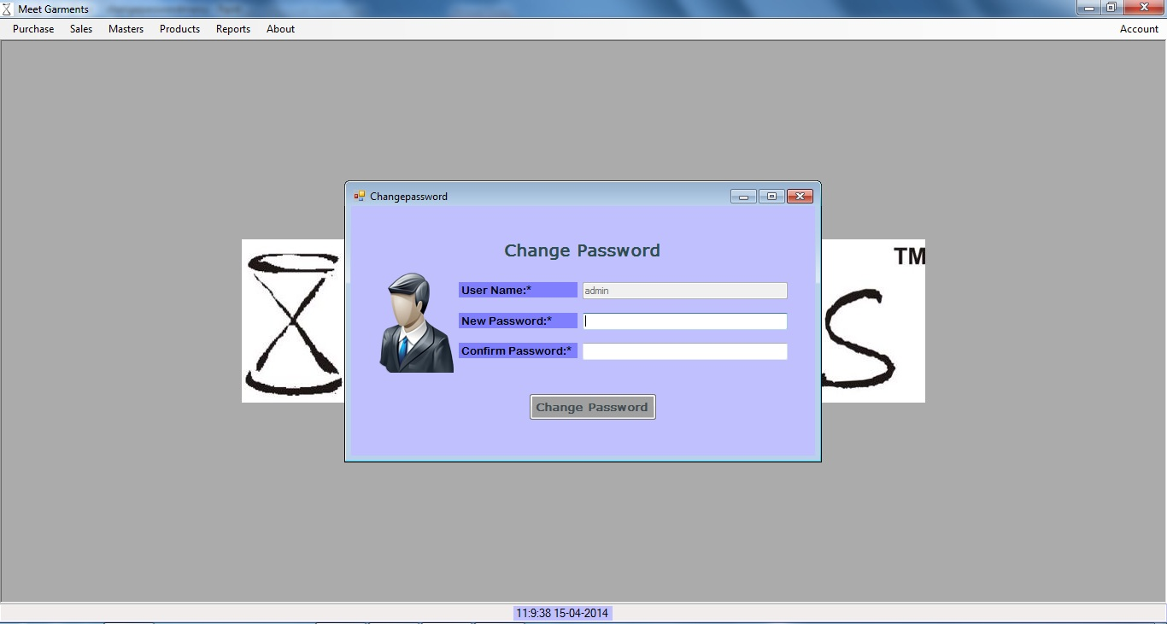
Login
AHMEDABAD UNIVERSITY SCHOOL OF COMPUTER STUDIES(BCA Programme)

Slide 44
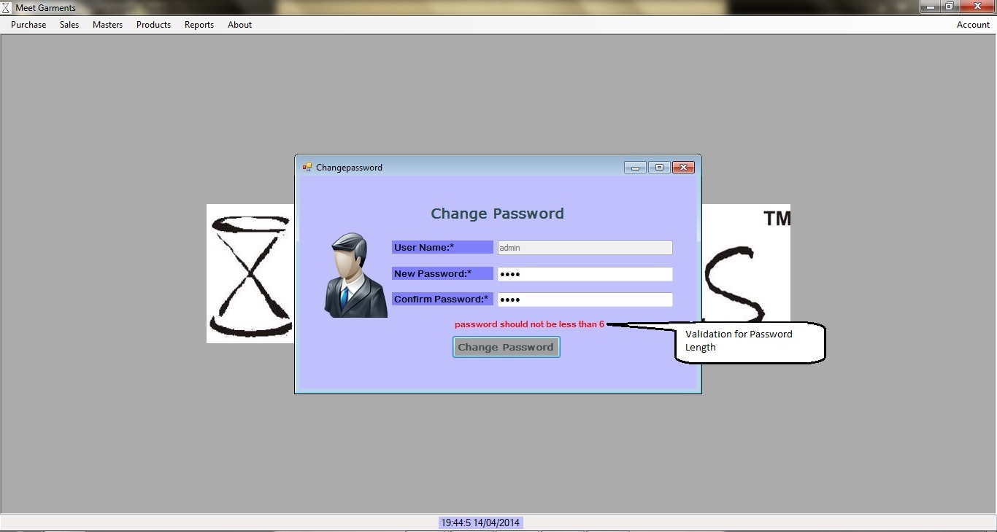
Login
AHMEDABAD UNIVERSITY SCHOOL OF COMPUTER STUDIES(BCA Programme)

Slide 45
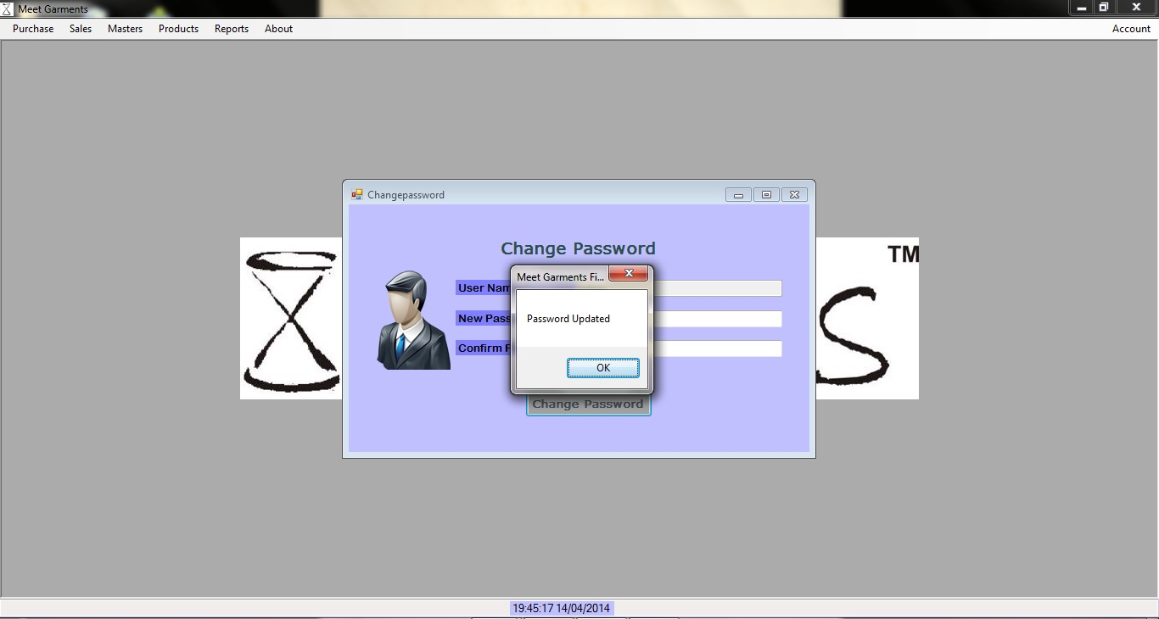
Login
AHMEDABAD UNIVERSITY SCHOOL OF COMPUTER STUDIES(BCA Programme)

Slide 46
Home
AHMEDABAD UNIVERSITY SCHOOL OF COMPUTER STUDIES(BCA Programme)

Slide 47
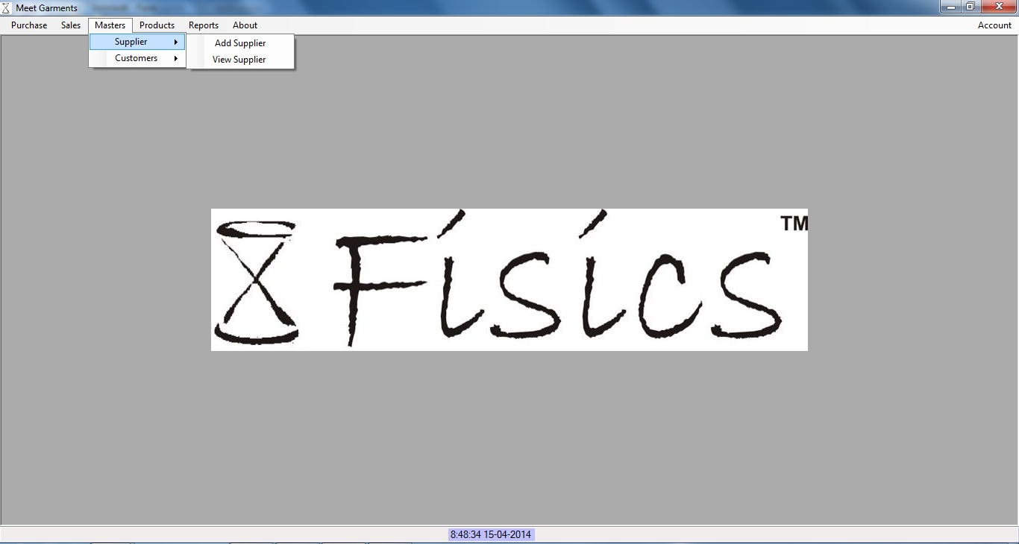
Add Supplier Details
AHMEDABAD UNIVERSITY SCHOOL OF COMPUTER STUDIES(BCA Programme)

Slide 48
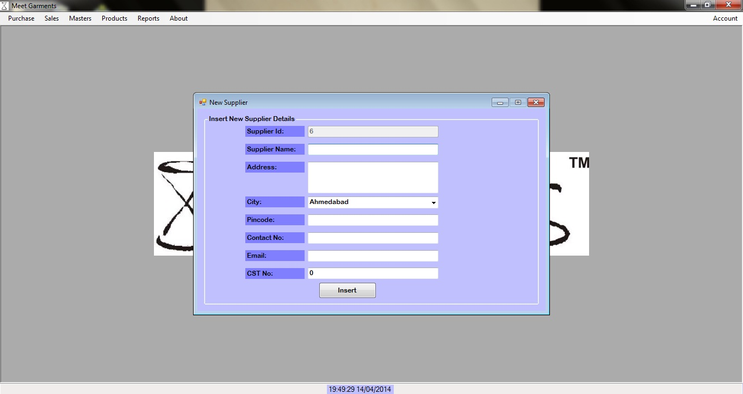
Add Supplier Details
AHMEDABAD UNIVERSITY SCHOOL OF COMPUTER STUDIES(BCA Programme)

Slide 49
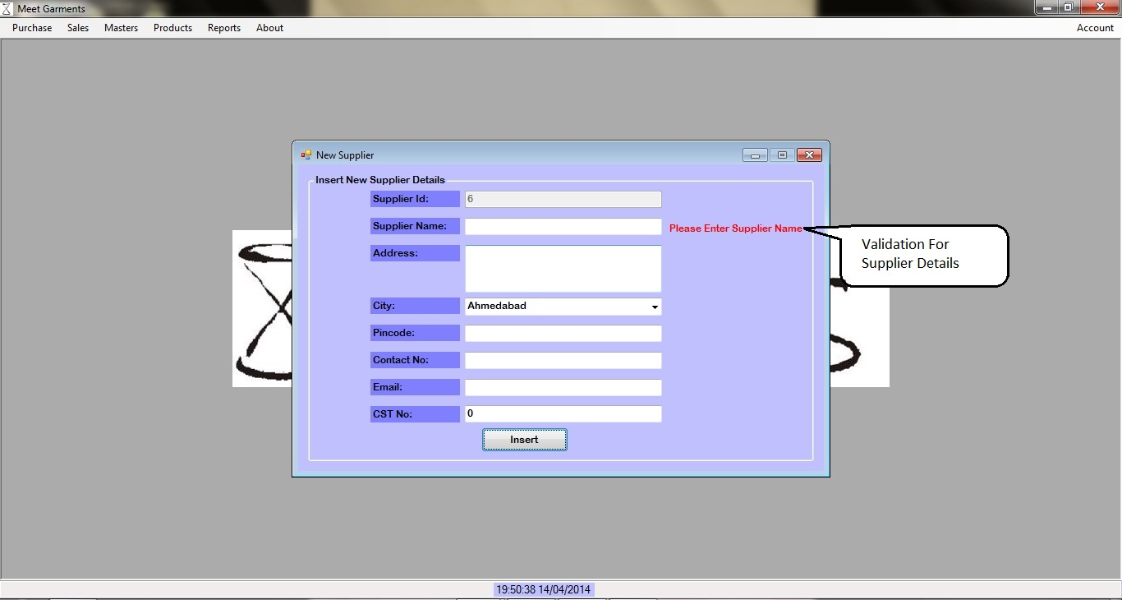
Add Supplier Details
AHMEDABAD UNIVERSITY SCHOOL OF COMPUTER STUDIES(BCA Programme)

Slide 50
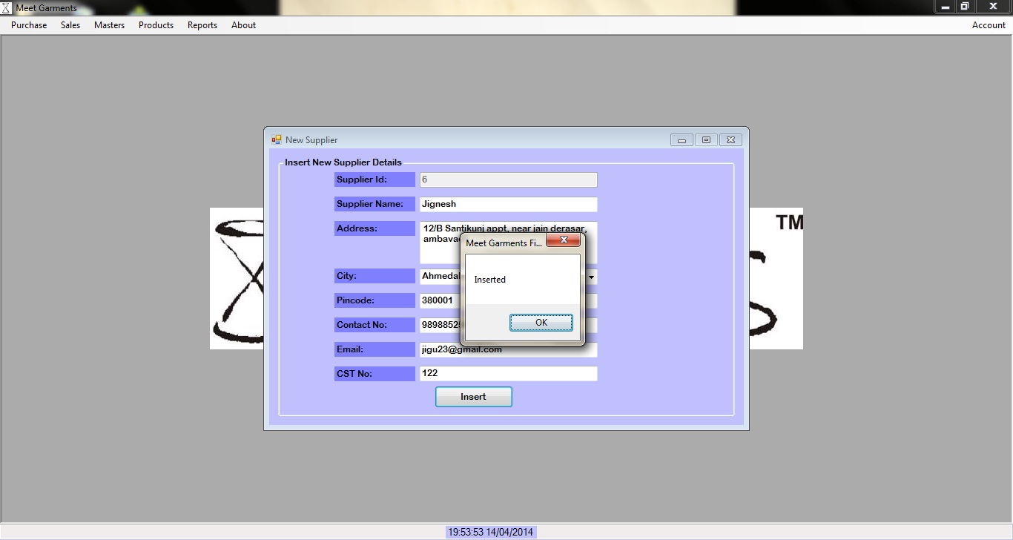
Add Supplier Details
AHMEDABAD UNIVERSITY SCHOOL OF COMPUTER STUDIES(BCA Programme)

Slide 51
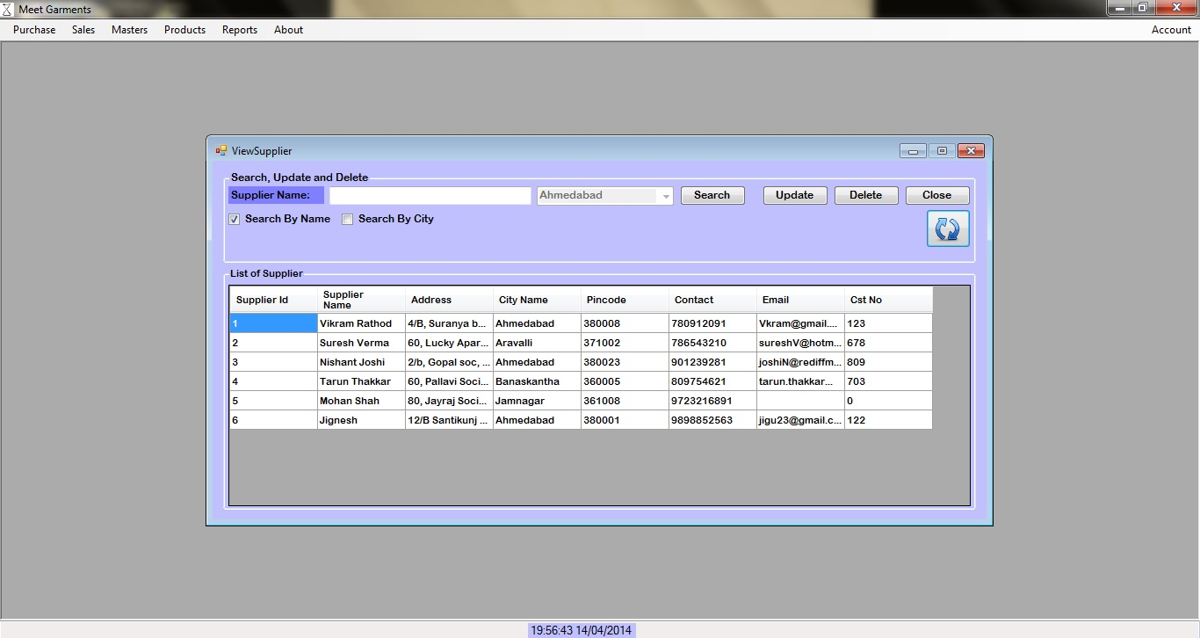
View Supplier Details
AHMEDABAD UNIVERSITY SCHOOL OF COMPUTER STUDIES(BCA Programme)

Slide 52
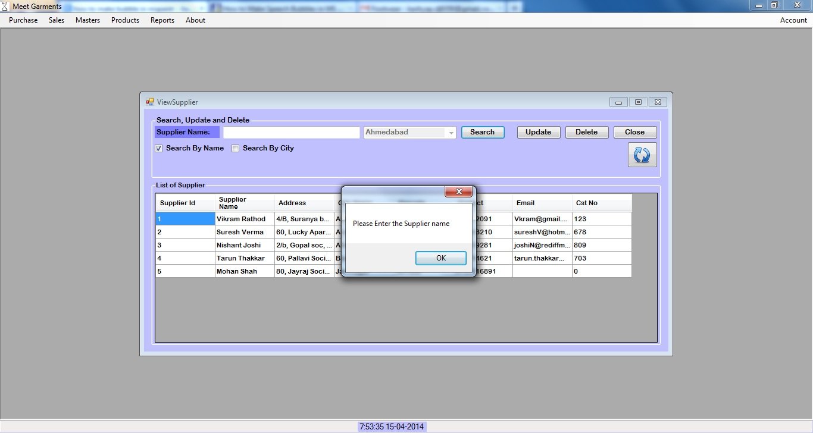
Validation
AHMEDABAD UNIVERSITY SCHOOL OF COMPUTER STUDIES(BCA Programme)

Slide 53
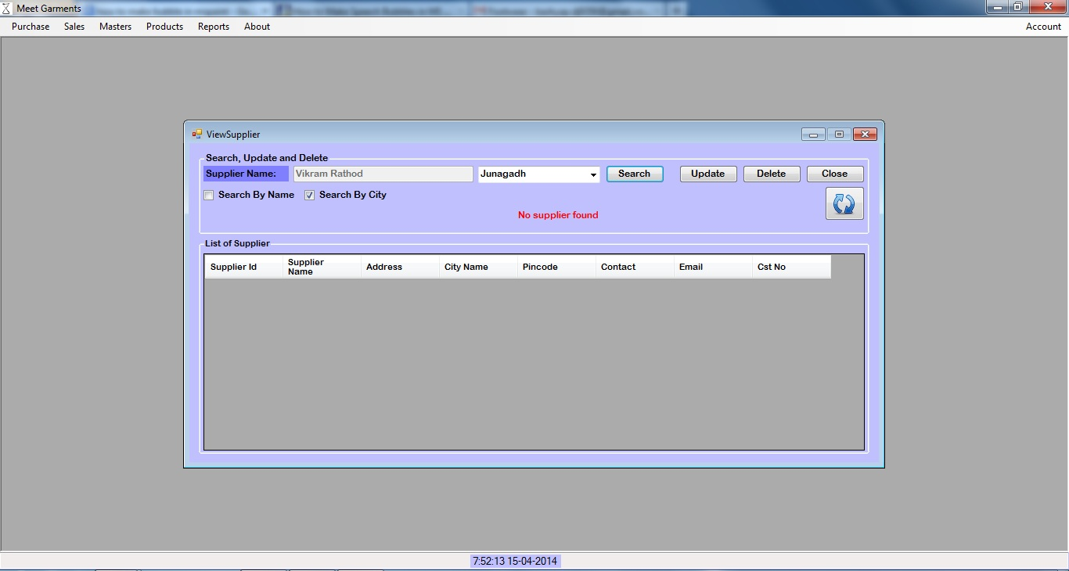
Validation
AHMEDABAD UNIVERSITY SCHOOL OF COMPUTER STUDIES(BCA Programme)

Slide 54
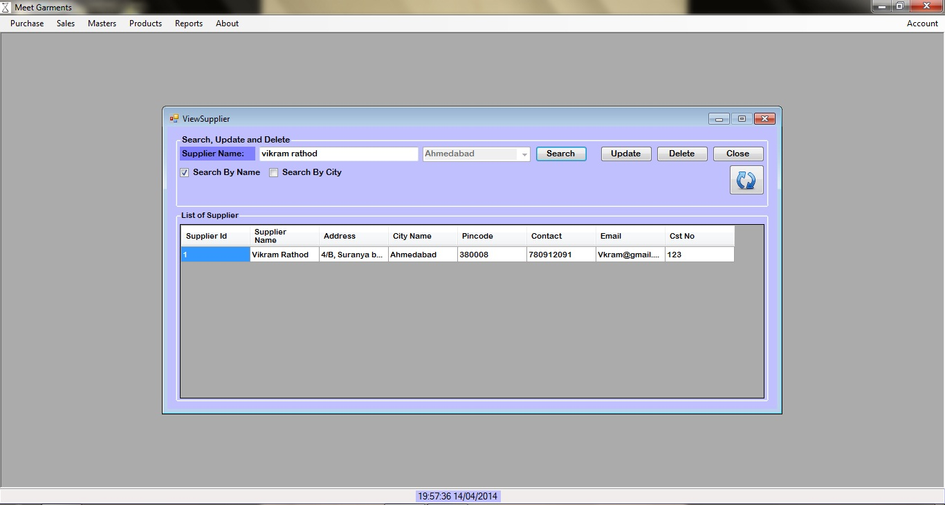
Search By Name
AHMEDABAD UNIVERSITY SCHOOL OF COMPUTER STUDIES(BCA Programme)

Slide 55
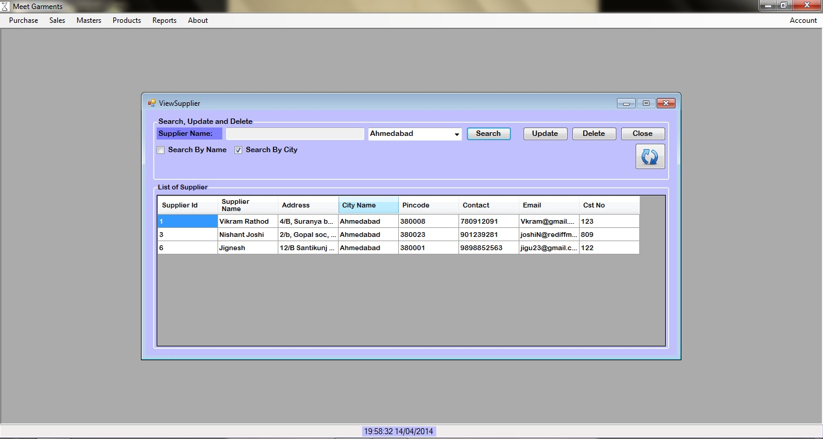
Search By City
AHMEDABAD UNIVERSITY SCHOOL OF COMPUTER STUDIES(BCA Programme)

Slide 56
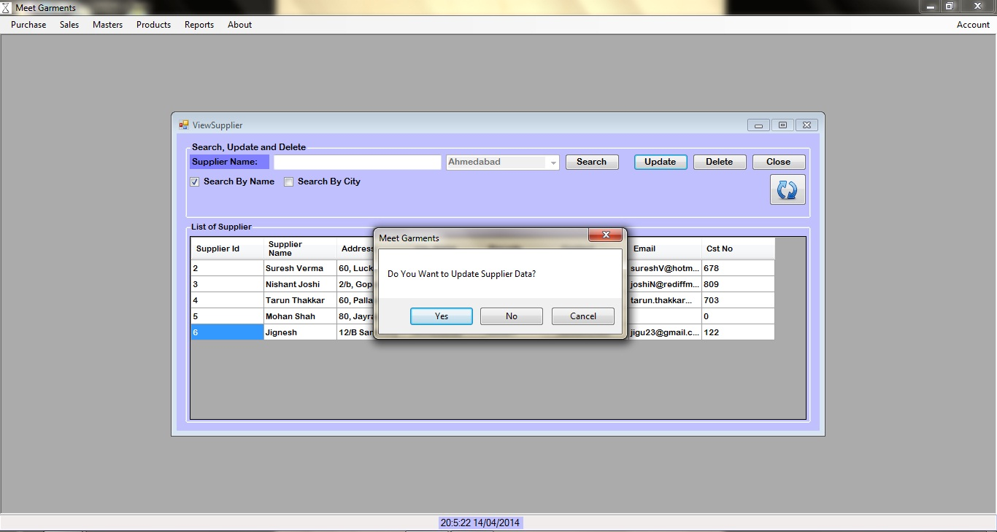
Update Supplier Details
AHMEDABAD UNIVERSITY SCHOOL OF COMPUTER STUDIES(BCA Programme)

Slide 57
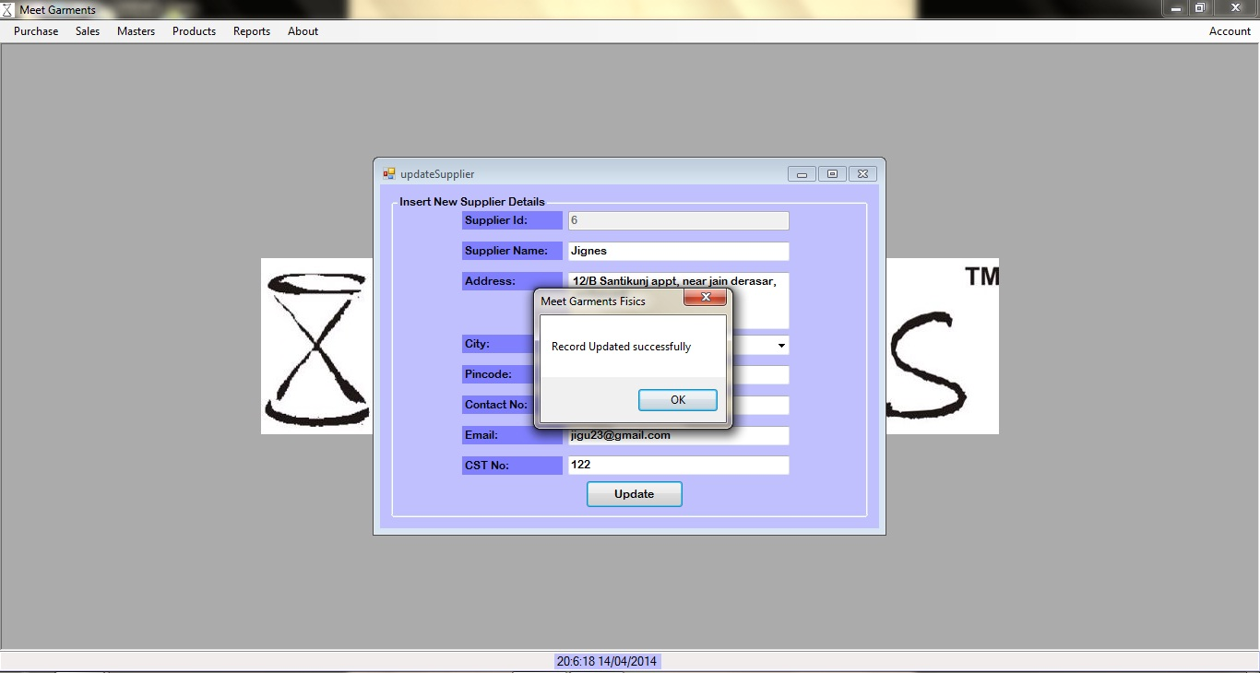
Update Supplier Details
AHMEDABAD UNIVERSITY SCHOOL OF COMPUTER STUDIES(BCA Programme)

Slide 58
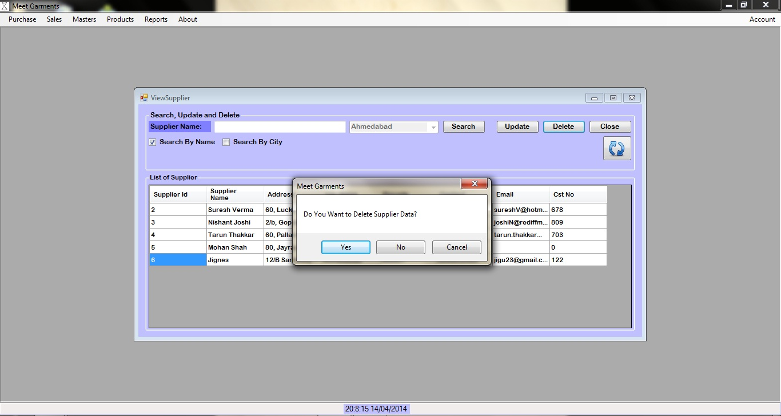
Delete Supplier Details
AHMEDABAD UNIVERSITY SCHOOL OF COMPUTER STUDIES(BCA Programme)

Slide 59
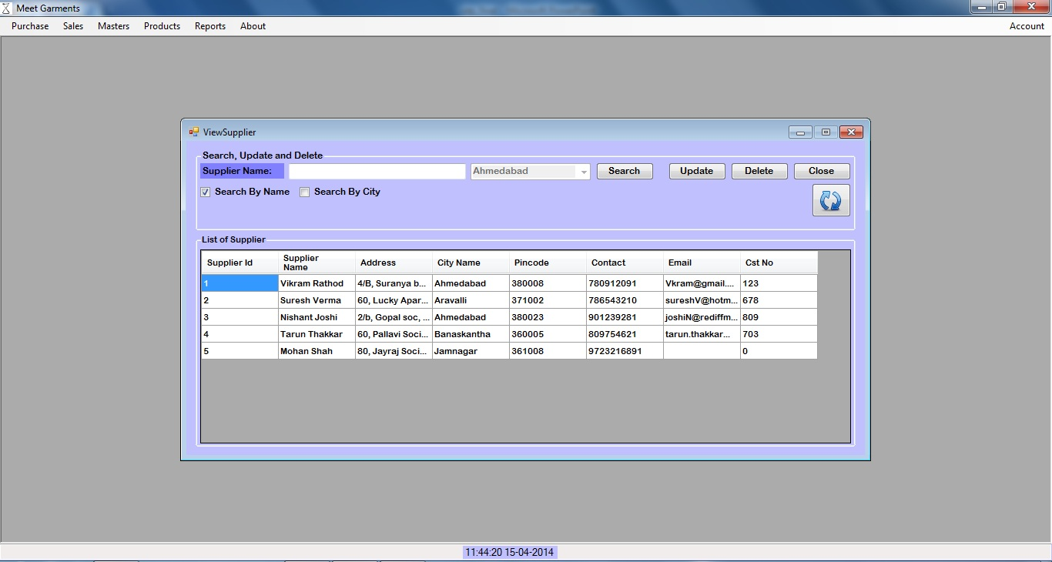
Delete Supplier Details
AHMEDABAD UNIVERSITY SCHOOL OF COMPUTER STUDIES(BCA Programme)

Slide 60
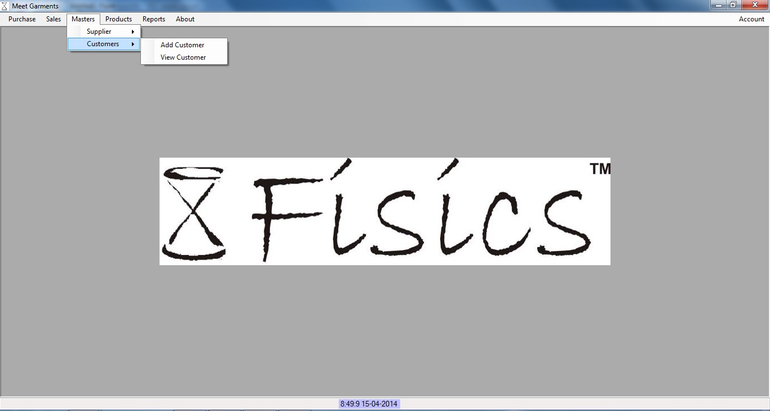
Add Customer Details
AHMEDABAD UNIVERSITY SCHOOL OF COMPUTER STUDIES(BCA Programme)

Slide 61
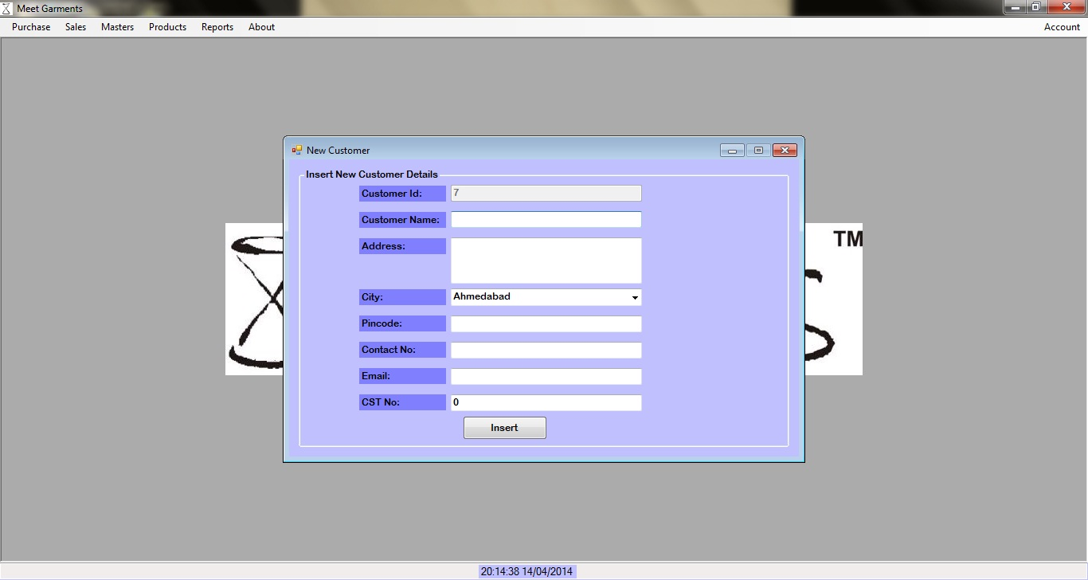
Add Customer Details
AHMEDABAD UNIVERSITY SCHOOL OF COMPUTER STUDIES(BCA Programme)

Slide 62
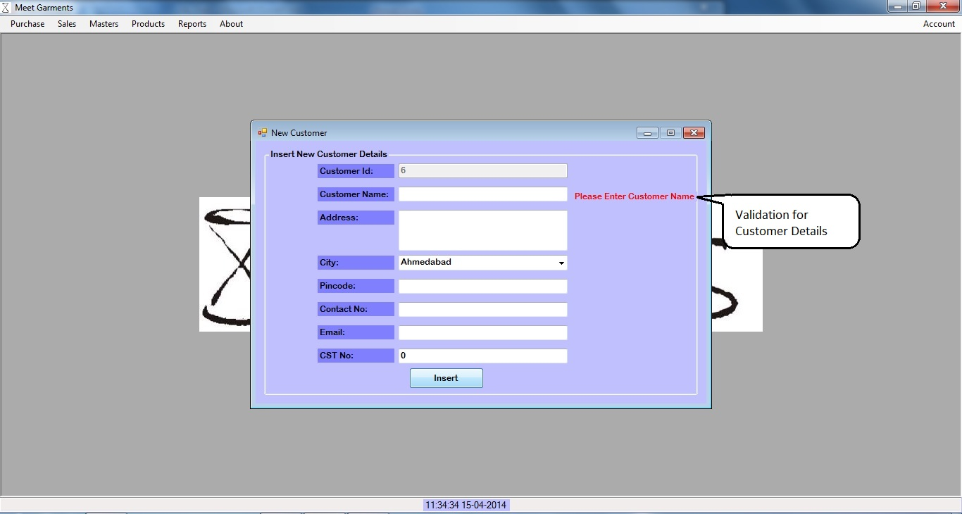
Add Customer Details
AHMEDABAD UNIVERSITY SCHOOL OF COMPUTER STUDIES(BCA Programme)

Slide 63
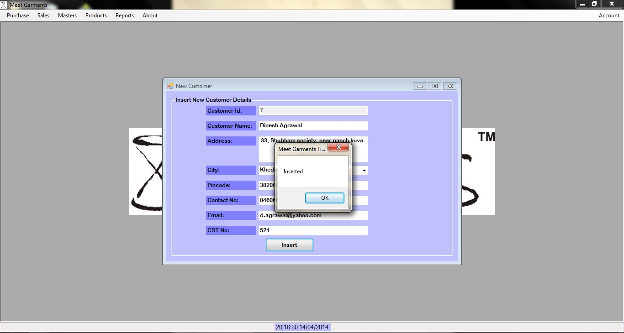
Add Customer Details
AHMEDABAD UNIVERSITY SCHOOL OF COMPUTER STUDIES(BCA Programme)

Slide 64
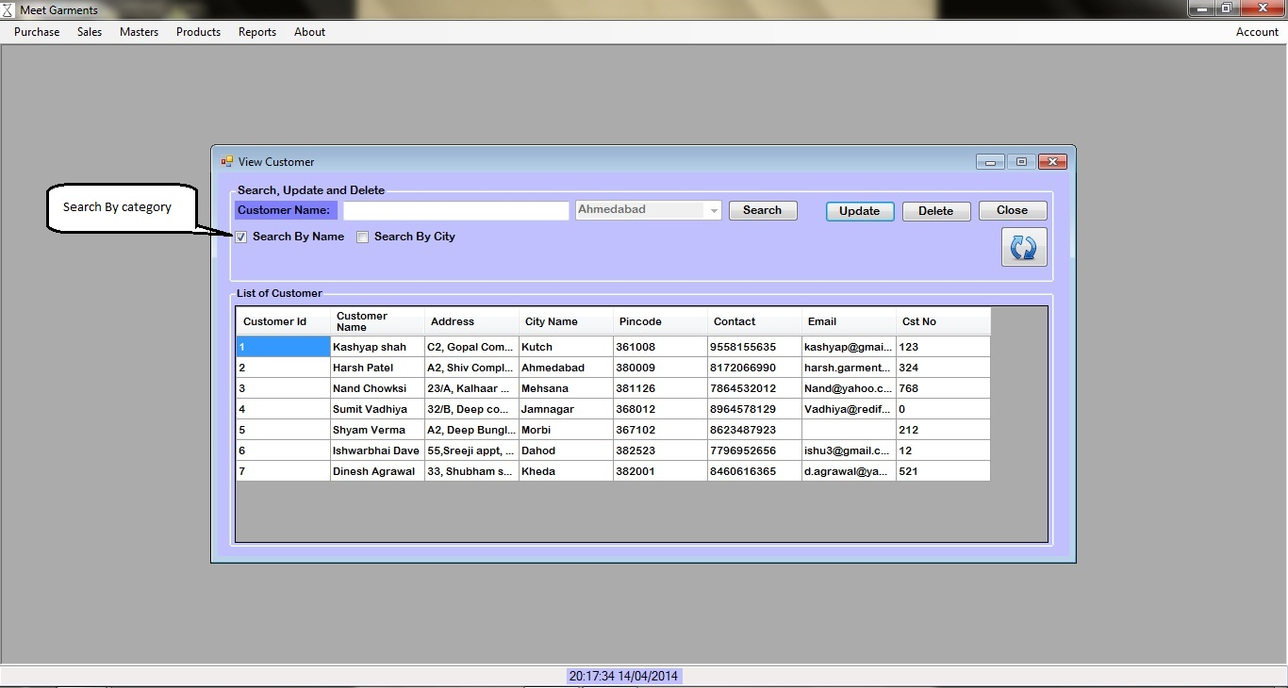
View Customer Details
AHMEDABAD UNIVERSITY SCHOOL OF COMPUTER STUDIES(BCA Programme)

Slide 65
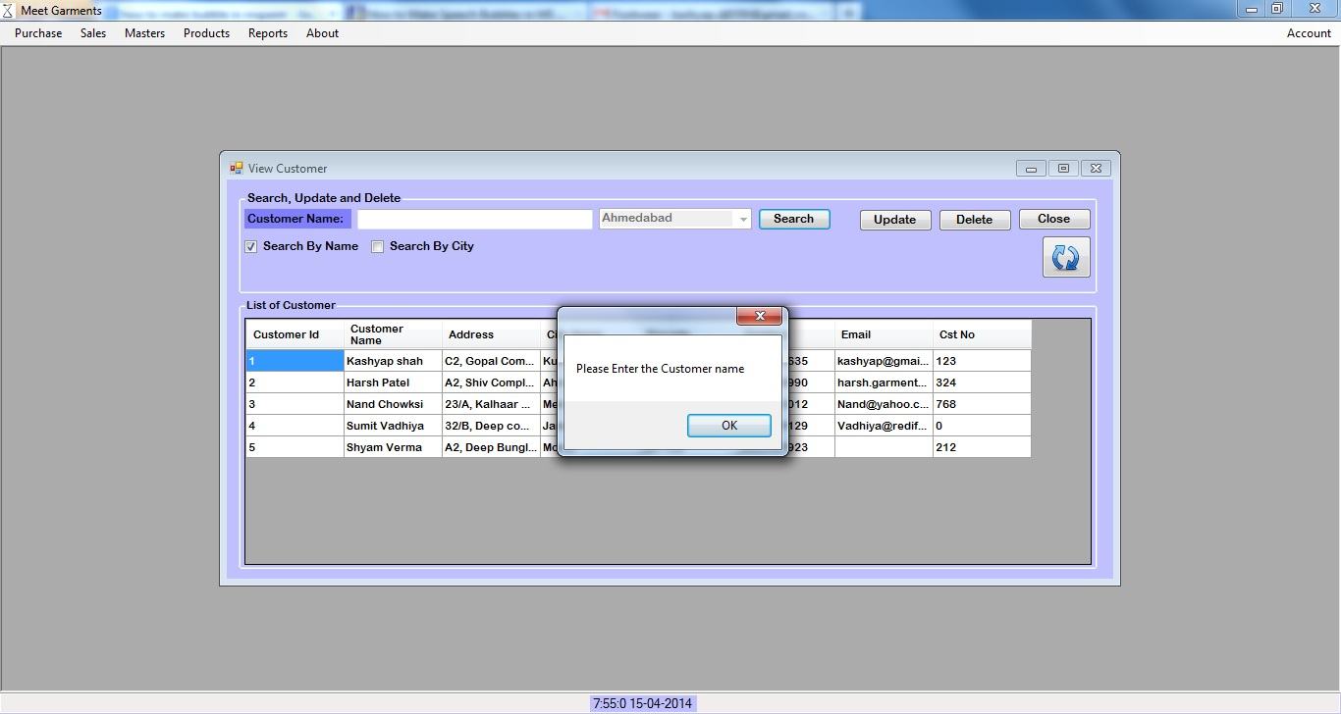
Validation
AHMEDABAD UNIVERSITY SCHOOL OF COMPUTER STUDIES(BCA Programme)

Slide 66
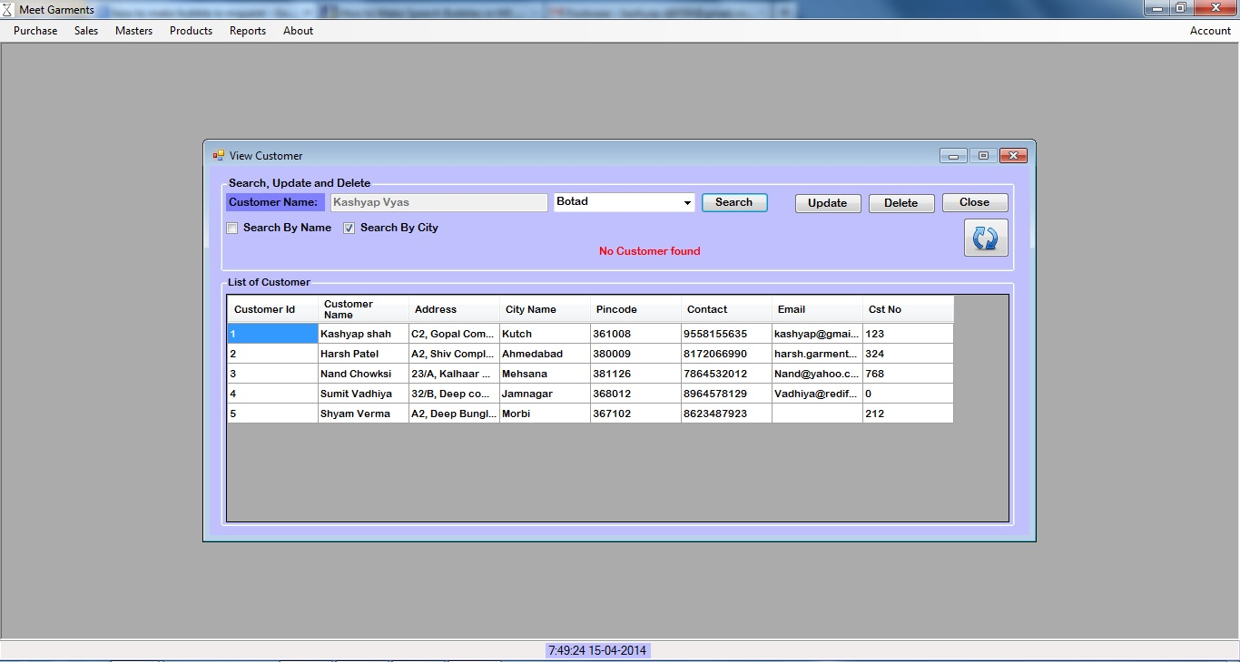
Validation
AHMEDABAD UNIVERSITY SCHOOL OF COMPUTER STUDIES(BCA Programme)

Slide 67
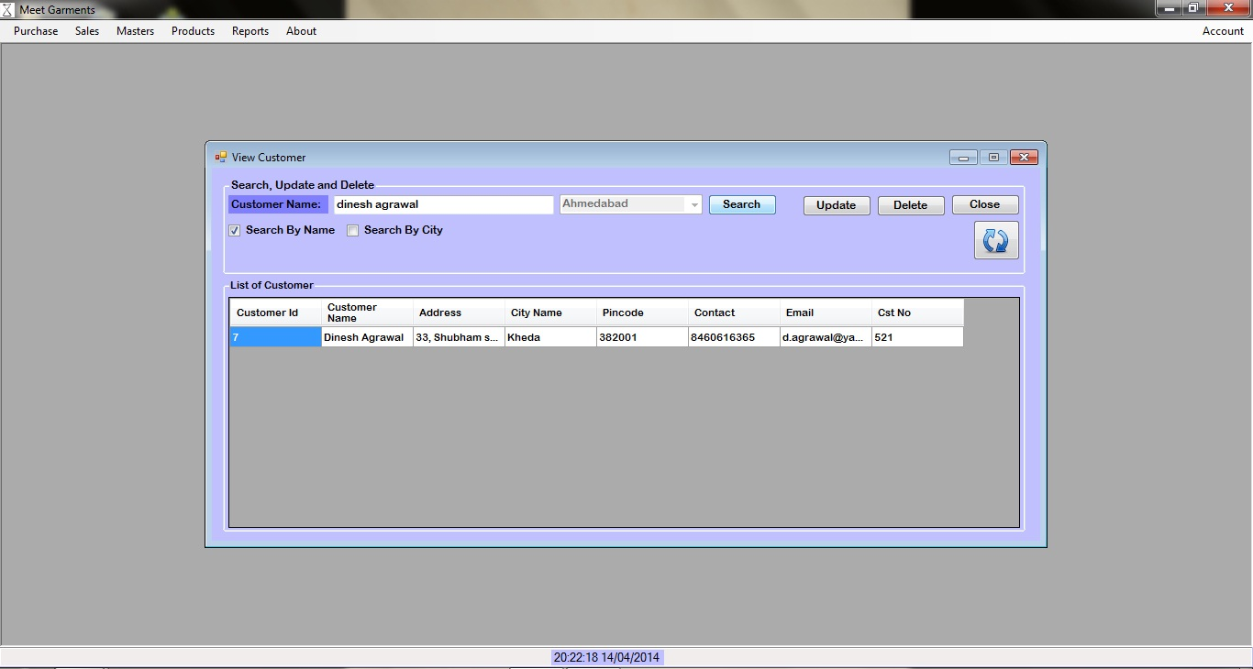
Search By Name
AHMEDABAD UNIVERSITY SCHOOL OF COMPUTER STUDIES(BCA Programme)

Slide 68

Search By City
AHMEDABAD UNIVERSITY SCHOOL OF COMPUTER STUDIES(BCA Programme)

Slide 69
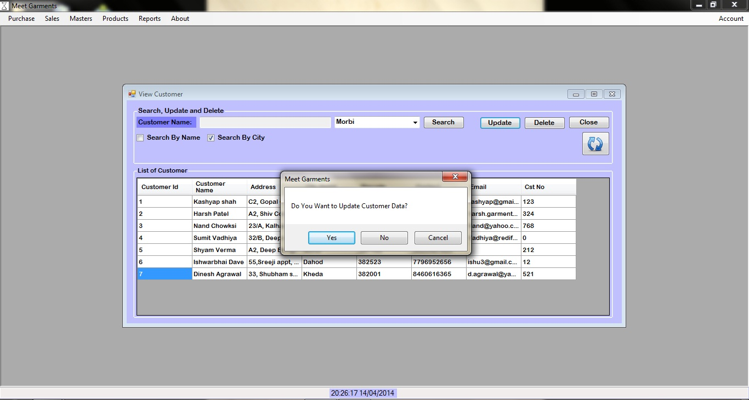
Update Customer Details
AHMEDABAD UNIVERSITY SCHOOL OF COMPUTER STUDIES(BCA Programme)

Slide 70
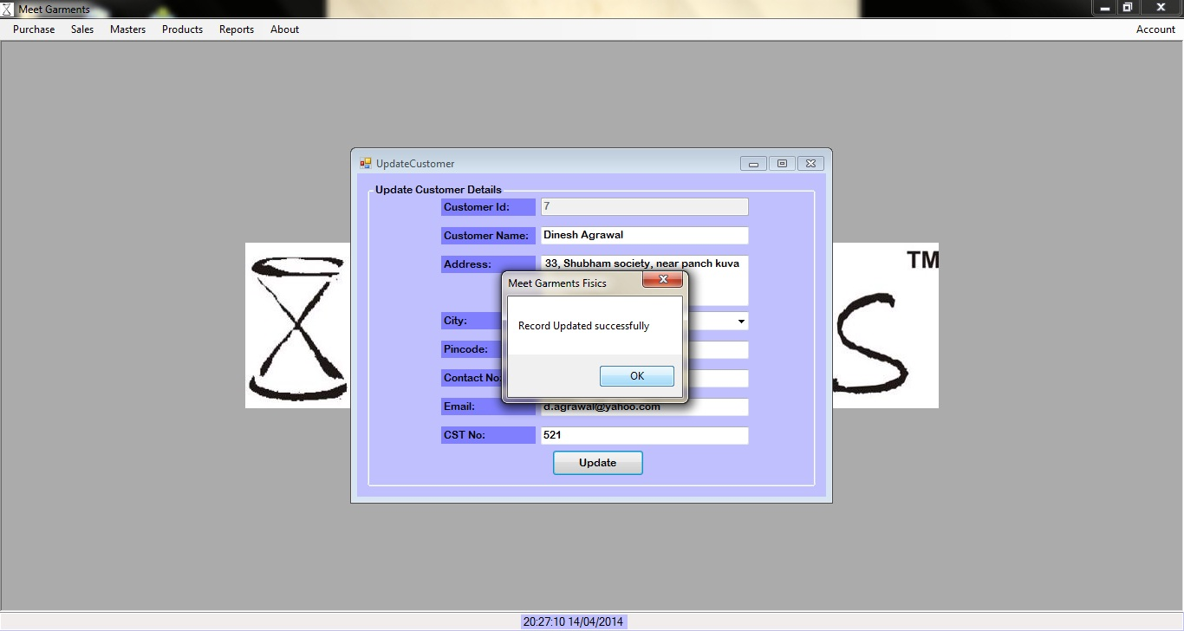
Update Customer Details
AHMEDABAD UNIVERSITY SCHOOL OF COMPUTER STUDIES(BCA Programme)

Slide 71
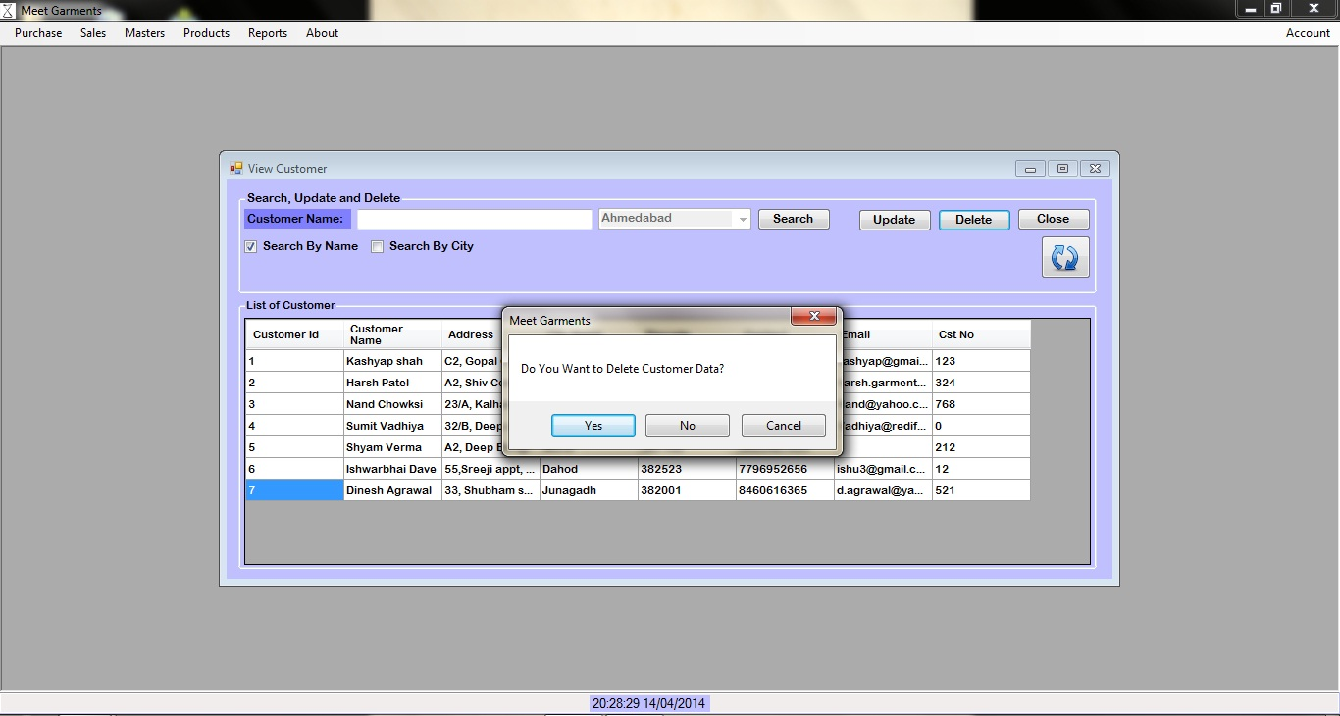
Delete Customer Details
AHMEDABAD UNIVERSITY SCHOOL OF COMPUTER STUDIES(BCA Programme)

Slide 72
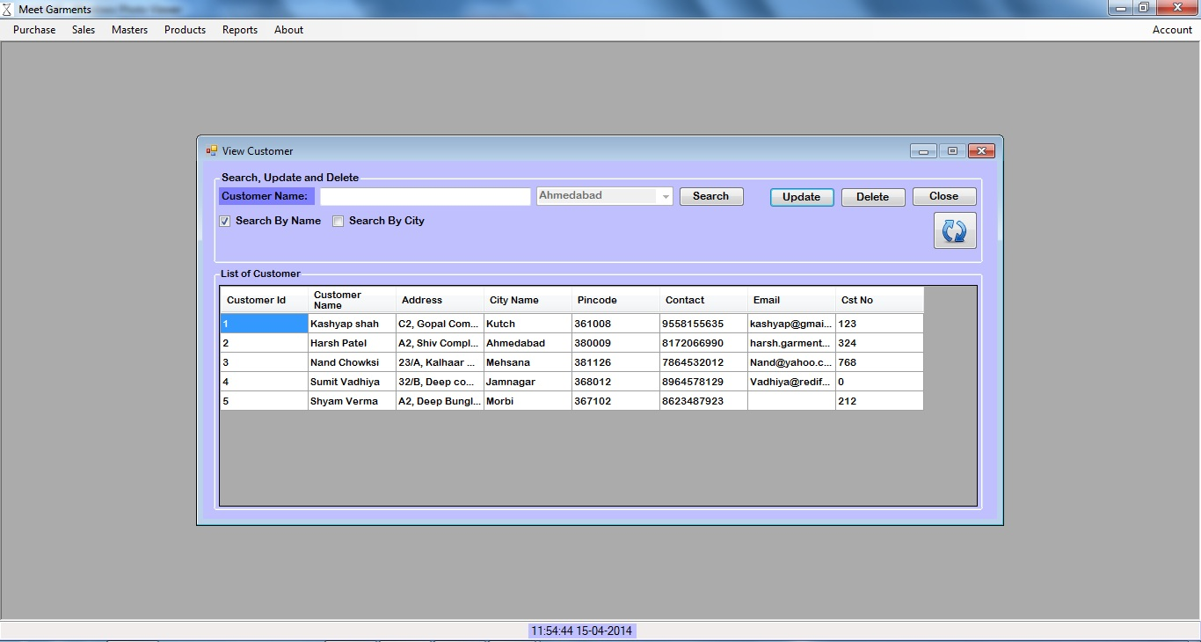
Delete Customer Details
AHMEDABAD UNIVERSITY SCHOOL OF COMPUTER STUDIES(BCA Programme)

Slide 73
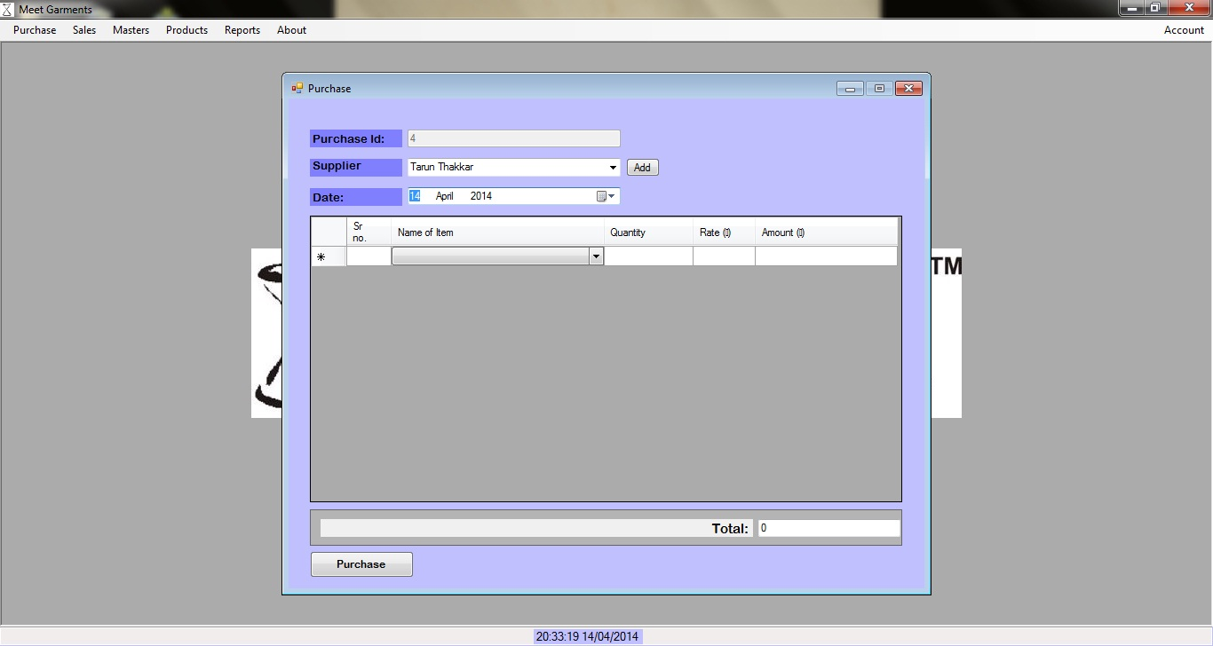
Add Purchase Details
AHMEDABAD UNIVERSITY SCHOOL OF COMPUTER STUDIES(BCA Programme)

Slide 74
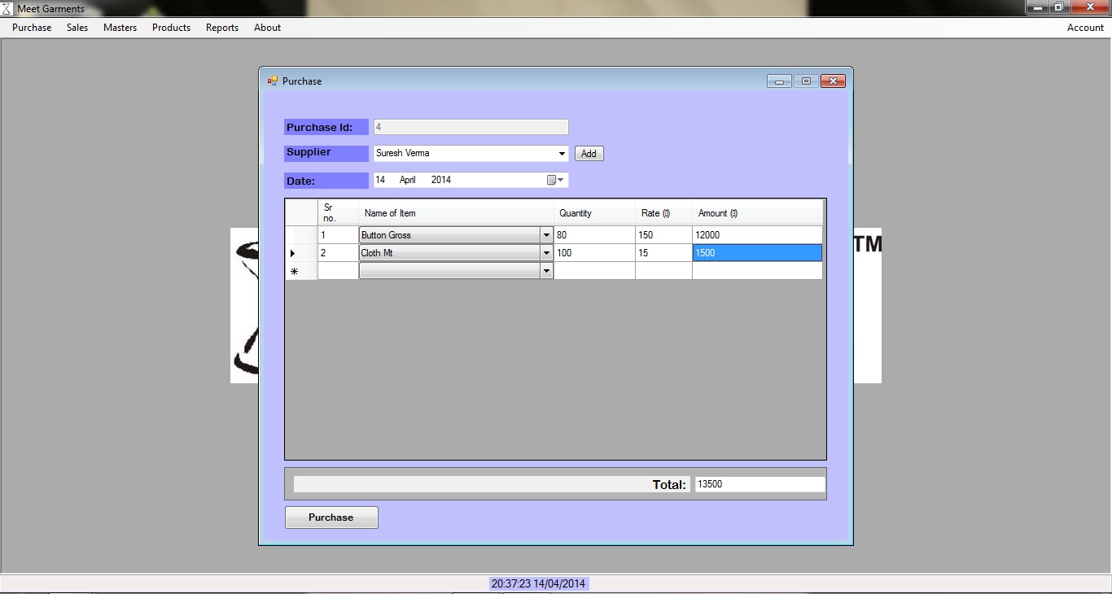
Add Purchase Details
AHMEDABAD UNIVERSITY SCHOOL OF COMPUTER STUDIES(BCA Programme)

Slide 75
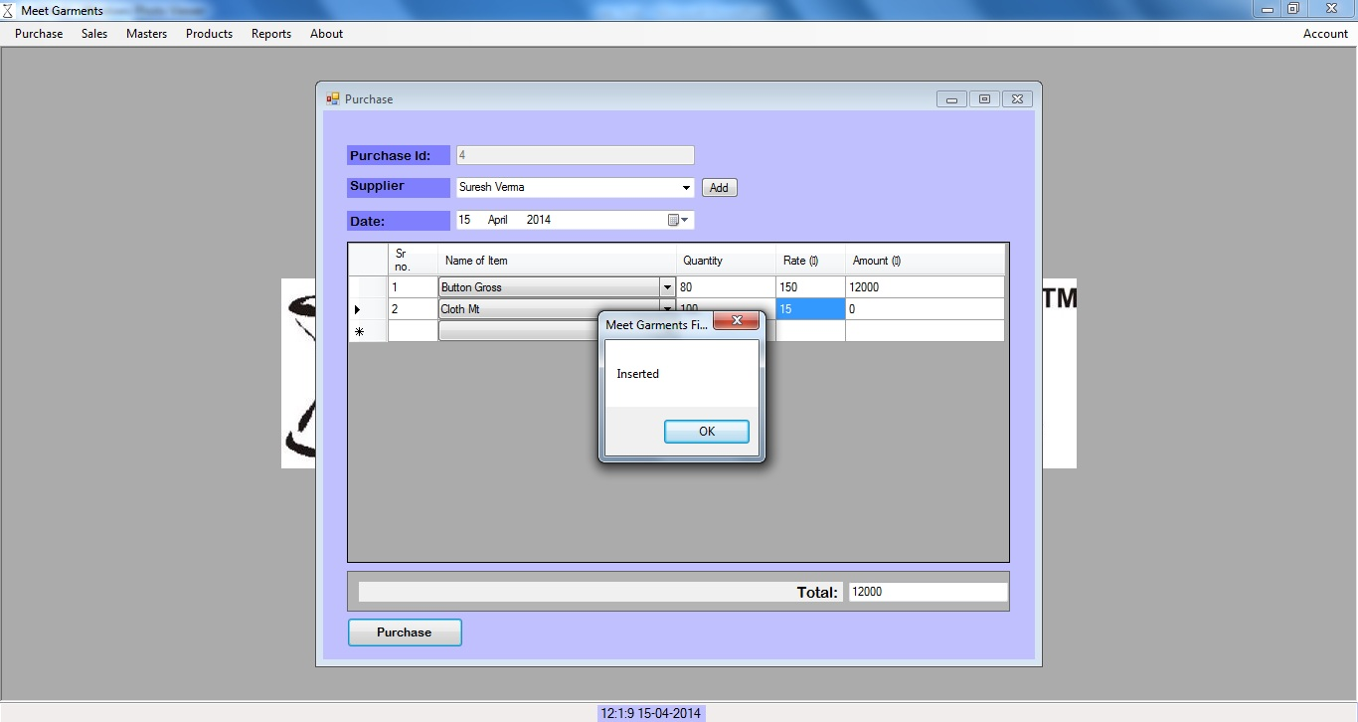
Add Purchase Details
AHMEDABAD UNIVERSITY SCHOOL OF COMPUTER STUDIES(BCA Programme)

Slide 76
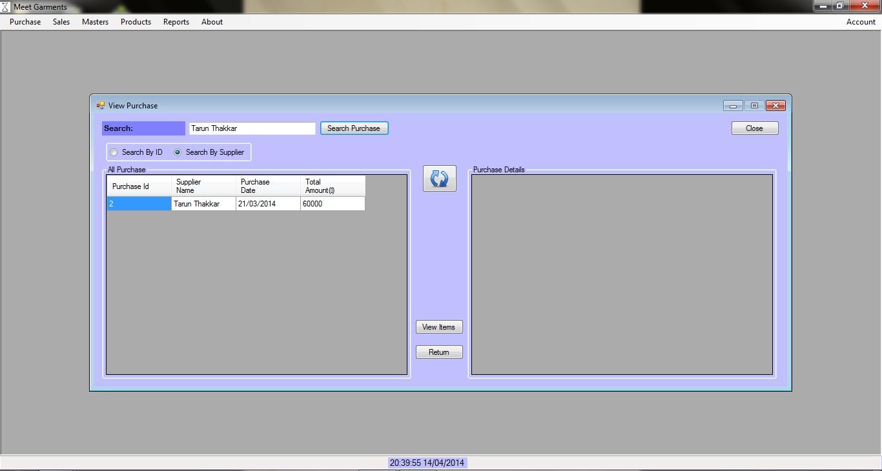
Search By Supplier
AHMEDABAD UNIVERSITY SCHOOL OF COMPUTER STUDIES(BCA Programme)

Slide 77
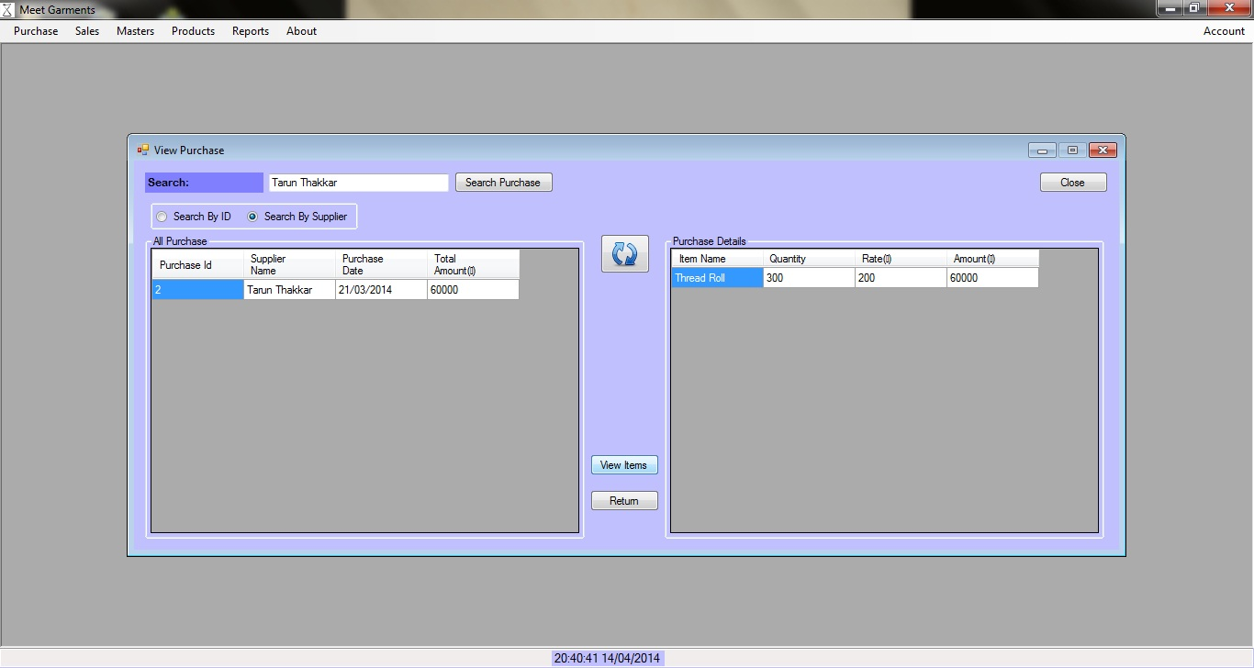
View Item
AHMEDABAD UNIVERSITY SCHOOL OF COMPUTER STUDIES(BCA Programme)

Slide 78
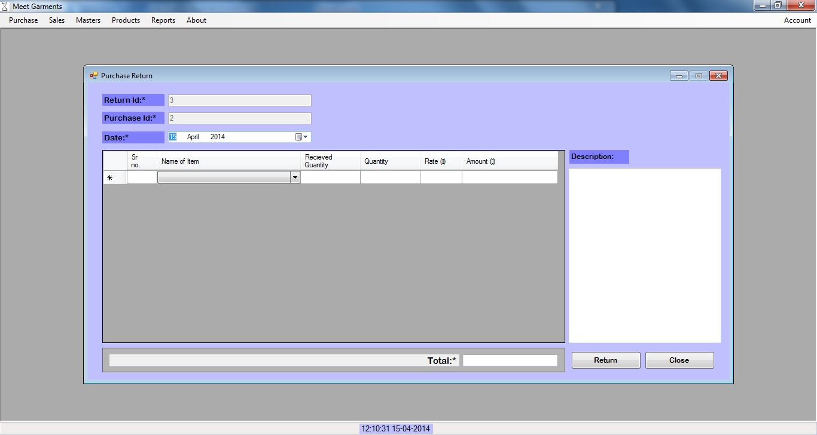
Purchase Return
AHMEDABAD UNIVERSITY SCHOOL OF COMPUTER STUDIES(BCA Programme)

Slide 79
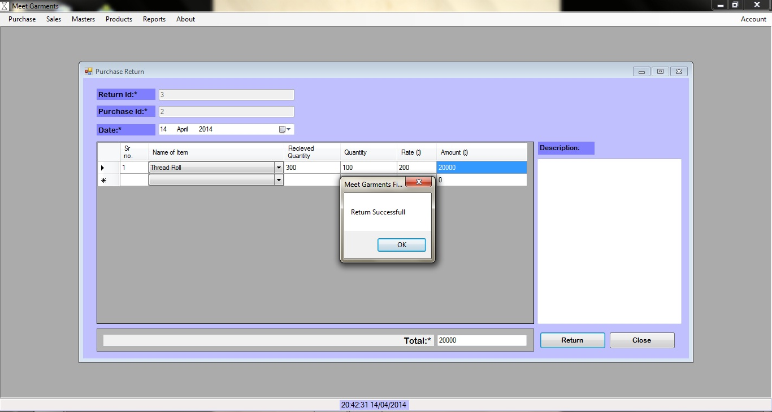
Purchase Return
AHMEDABAD UNIVERSITY SCHOOL OF COMPUTER STUDIES(BCA Programme)

Slide 80
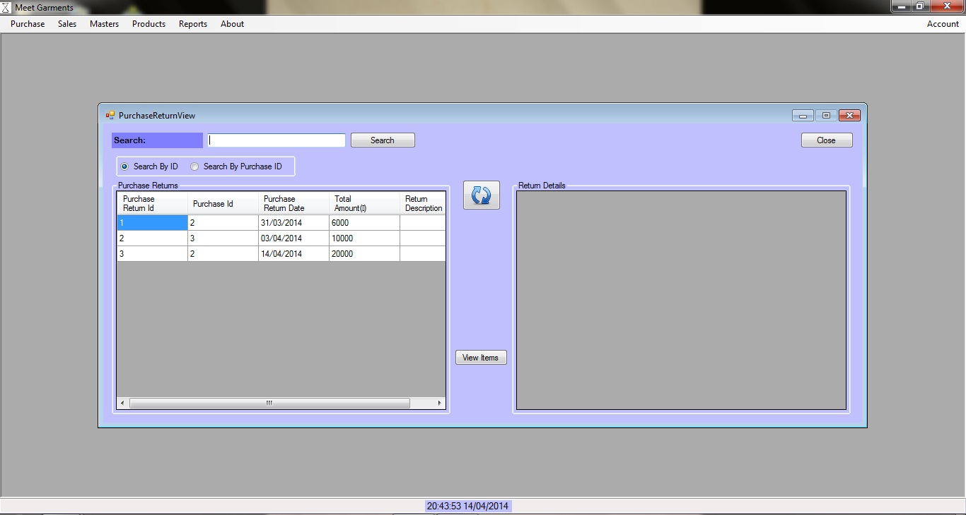
Purchase Return View
AHMEDABAD UNIVERSITY SCHOOL OF COMPUTER STUDIES(BCA Programme)

Slide 81
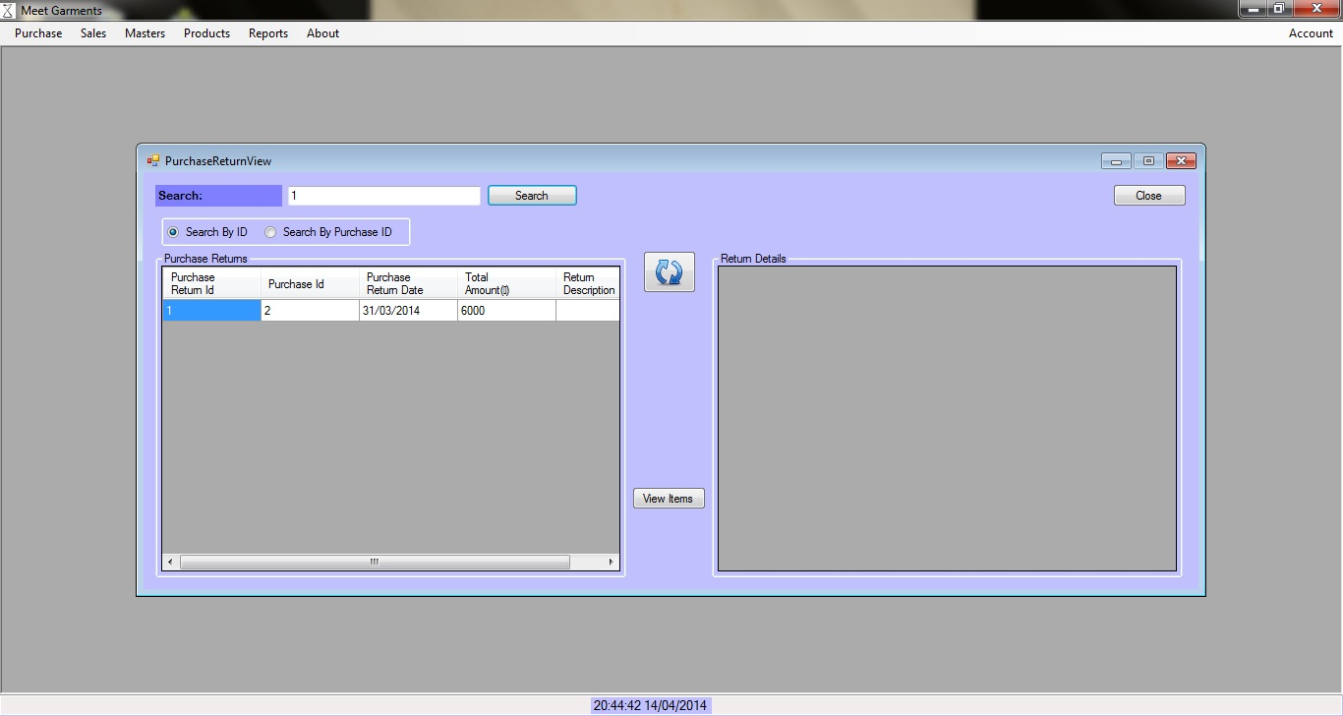
Search By Id
AHMEDABAD UNIVERSITY SCHOOL OF COMPUTER STUDIES(BCA Programme)

Slide 82

Search By Purchase Id
AHMEDABAD UNIVERSITY SCHOOL OF COMPUTER STUDIES(BCA Programme)

Slide 83
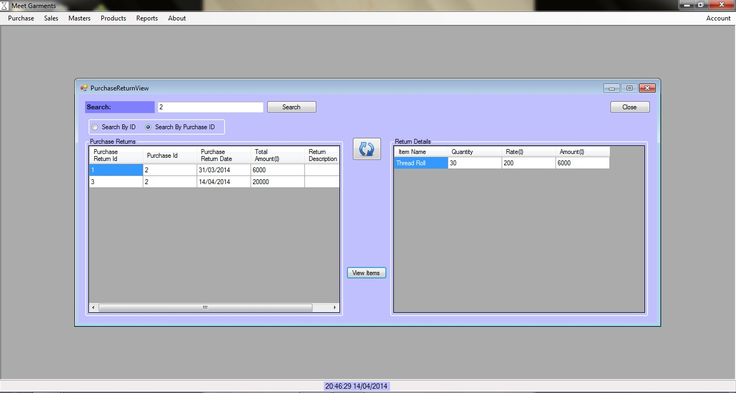
View Return Item
AHMEDABAD UNIVERSITY SCHOOL OF COMPUTER STUDIES(BCA Programme)

Slide 84
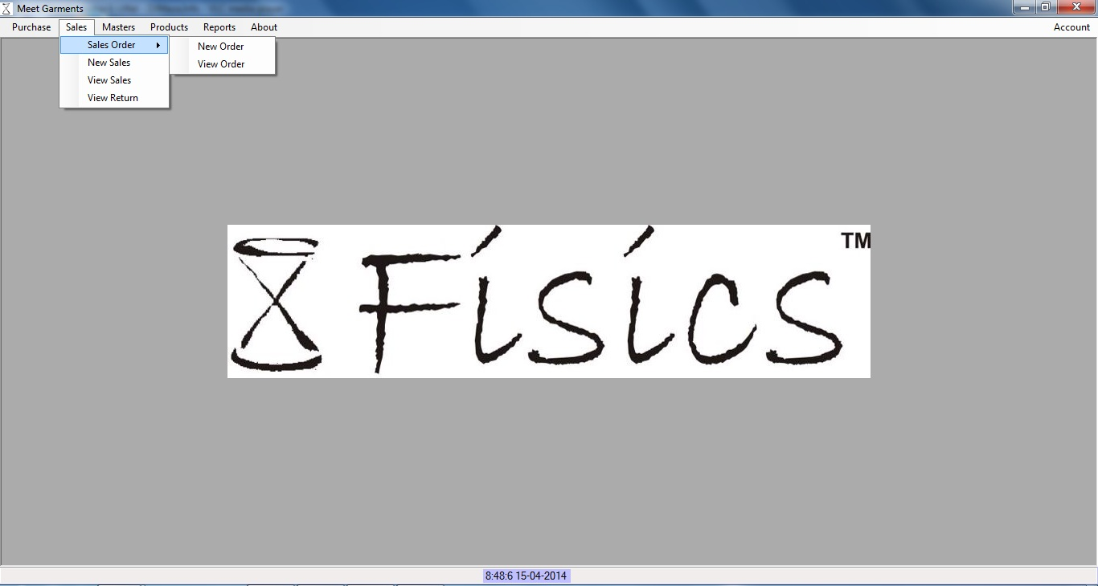
Take Sales Order
AHMEDABAD UNIVERSITY SCHOOL OF COMPUTER STUDIES(BCA Programme)

Slide 85
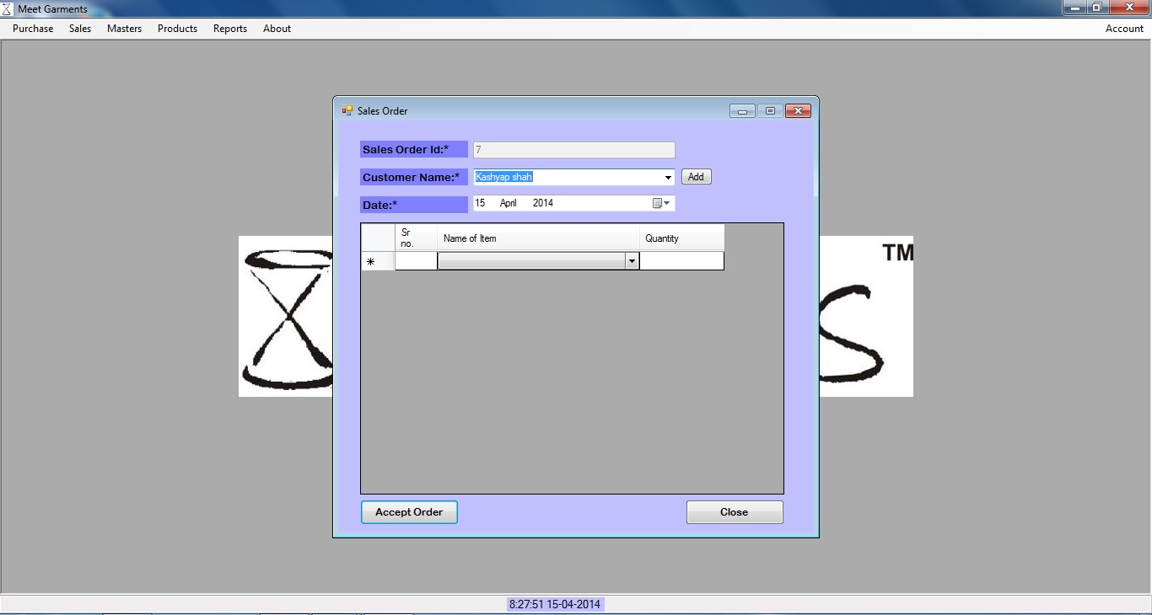
Add Sales Order
AHMEDABAD UNIVERSITY SCHOOL OF COMPUTER STUDIES(BCA Programme)

Slide 86
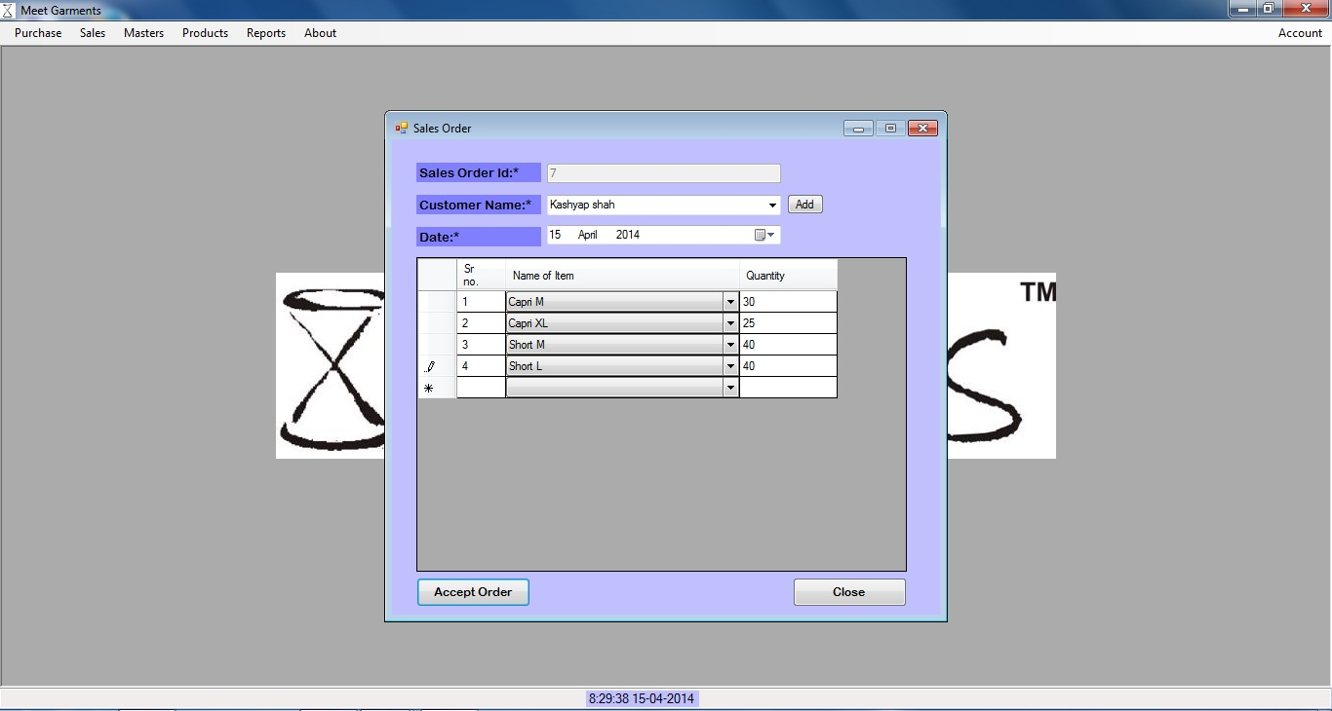
Add Sales Order
AHMEDABAD UNIVERSITY SCHOOL OF COMPUTER STUDIES(BCA Programme)

Slide 87
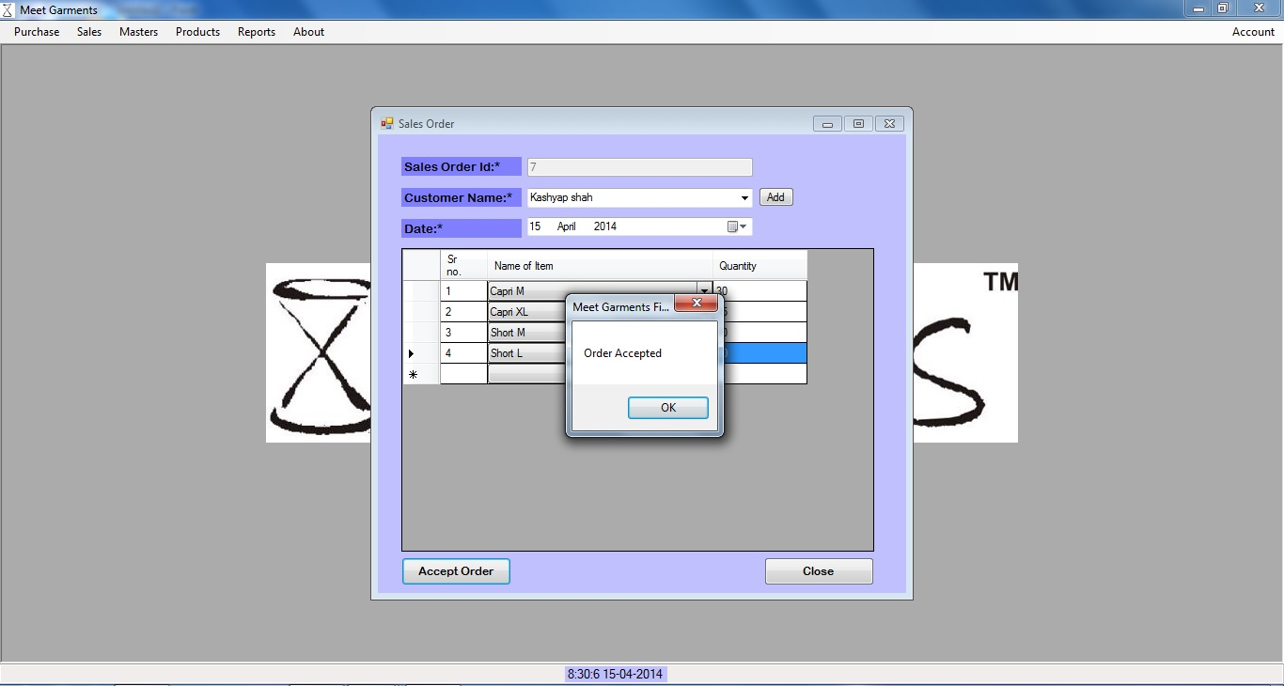
Add Sales Order
AHMEDABAD UNIVERSITY SCHOOL OF COMPUTER STUDIES(BCA Programme)

Slide 88
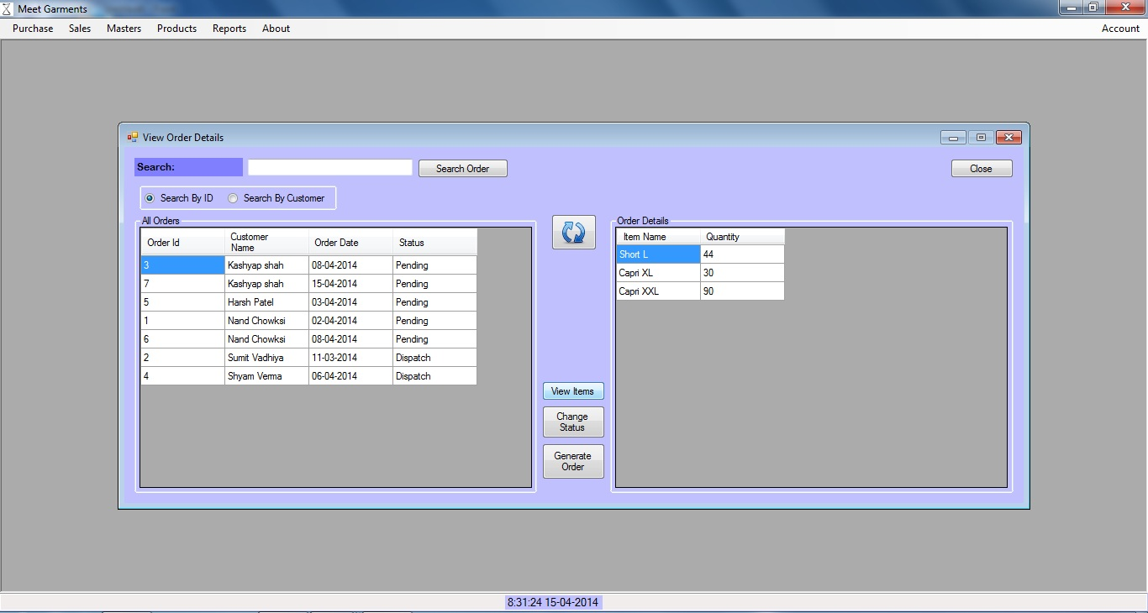
View Sales Order
AHMEDABAD UNIVERSITY SCHOOL OF COMPUTER STUDIES(BCA Programme)

Slide 89
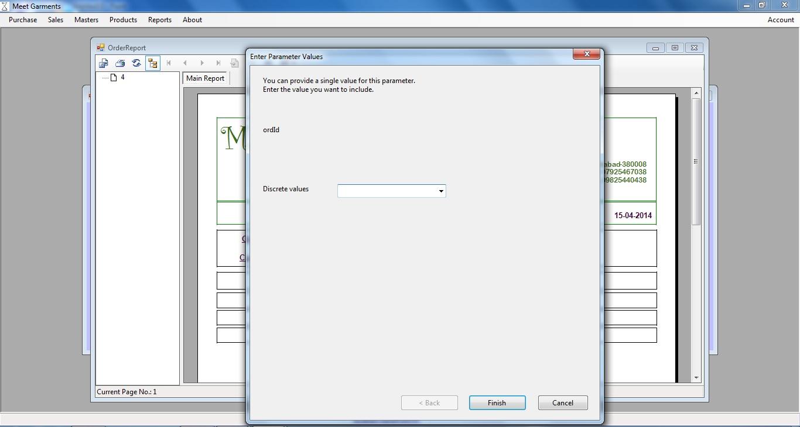
Insert Order Id In Report
AHMEDABAD UNIVERSITY SCHOOL OF COMPUTER STUDIES(BCA Programme)

Slide 90

Report Of Order
AHMEDABAD UNIVERSITY SCHOOL OF COMPUTER STUDIES(BCA Programme)

Slide 91

Add Order To Sales
AHMEDABAD UNIVERSITY SCHOOL OF COMPUTER STUDIES(BCA Programme)

Slide 92

Add Order To Sales
AHMEDABAD UNIVERSITY SCHOOL OF COMPUTER STUDIES(BCA Programme)

Slide 93

Add Order To Sales
AHMEDABAD UNIVERSITY SCHOOL OF COMPUTER STUDIES(BCA Programme)

Slide 94

Add Sales Details
AHMEDABAD UNIVERSITY SCHOOL OF COMPUTER STUDIES(BCA Programme)

Slide 95

Add Sales Details
AHMEDABAD UNIVERSITY SCHOOL OF COMPUTER STUDIES(BCA Programme)

Slide 96

Validation
AHMEDABAD UNIVERSITY SCHOOL OF COMPUTER STUDIES(BCA Programme)

Slide 97

Add Sales Details
AHMEDABAD UNIVERSITY SCHOOL OF COMPUTER STUDIES(BCA Programme)

Slide 98

View Sales
AHMEDABAD UNIVERSITY SCHOOL OF COMPUTER STUDIES(BCA Programme)

Slide 99

Validation
AHMEDABAD UNIVERSITY SCHOOL OF COMPUTER STUDIES(BCA Programme)

Slide 100

Validation
AHMEDABAD UNIVERSITY SCHOOL OF COMPUTER STUDIES(BCA Programme)

Slide 101

Search By Customer Name
AHMEDABAD UNIVERSITY SCHOOL OF COMPUTER STUDIES(BCA Programme)

Slide 102

Validation
AHMEDABAD UNIVERSITY SCHOOL OF COMPUTER STUDIES(BCA Programme)

Slide 103

Sales Return
AHMEDABAD UNIVERSITY SCHOOL OF COMPUTER STUDIES(BCA Programme)

Slide 104

Sales Return Validation
AHMEDABAD UNIVERSITY SCHOOL OF COMPUTER STUDIES(BCA Programme)

Slide 105

Sales Return
AHMEDABAD UNIVERSITY SCHOOL OF COMPUTER STUDIES(BCA Programme)

Slide 106

Sales Return
AHMEDABAD UNIVERSITY SCHOOL OF COMPUTER STUDIES(BCA Programme)

Slide 107

View Sales Return
AHMEDABAD UNIVERSITY SCHOOL OF COMPUTER STUDIES(BCA Programme)

Slide 108

Add Sales Product
AHMEDABAD UNIVERSITY SCHOOL OF COMPUTER STUDIES(BCA Programme)

Slide 109

Add Sales Product
AHMEDABAD UNIVERSITY SCHOOL OF COMPUTER STUDIES(BCA Programme)

Slide 110

Add Sales Product
AHMEDABAD UNIVERSITY SCHOOL OF COMPUTER STUDIES(BCA Programme)

Slide 111

Add Sales Product
AHMEDABAD UNIVERSITY SCHOOL OF COMPUTER STUDIES(BCA Programme)

Slide 112

View Sales Item Stock
AHMEDABAD UNIVERSITY SCHOOL OF COMPUTER STUDIES(BCA Programme)

Slide 113

Search Items By Id
AHMEDABAD UNIVERSITY SCHOOL OF COMPUTER STUDIES(BCA Programme)

Slide 114

Search Items By Name
AHMEDABAD UNIVERSITY SCHOOL OF COMPUTER STUDIES(BCA Programme)

Slide 115

Add Purchase Product
AHMEDABAD UNIVERSITY SCHOOL OF COMPUTER STUDIES(BCA Programme)

Slide 116

Add Purchase Product
AHMEDABAD UNIVERSITY SCHOOL OF COMPUTER STUDIES(BCA Programme)

Slide 117

Add Purchase Product
AHMEDABAD UNIVERSITY SCHOOL OF COMPUTER STUDIES(BCA Programme)

Slide 118

Add Purchase Product
AHMEDABAD UNIVERSITY SCHOOL OF COMPUTER STUDIES(BCA Programme)

Slide 119

View Purchase Product
AHMEDABAD UNIVERSITY SCHOOL OF COMPUTER STUDIES(BCA Programme)

Slide 120

Search By Item Id
AHMEDABAD UNIVERSITY SCHOOL OF COMPUTER STUDIES(BCA Programme)

Slide 121

Search By Item Name
AHMEDABAD UNIVERSITY SCHOOL OF COMPUTER STUDIES(BCA Programme)

Slide 122
Reports Layouts
AHMEDABAD UNIVERSITY SCHOOL OF COMPUTER STUDIES(BCA Programme)

Slide 123

All Order
AHMEDABAD UNIVERSITY SCHOOL OF COMPUTER STUDIES(BCA Programme)

Slide 124

Order In Between Dates
AHMEDABAD UNIVERSITY SCHOOL OF COMPUTER STUDIES(BCA Programme)

Slide 125

Customer As On Dates
AHMEDABAD UNIVERSITY SCHOOL OF COMPUTER STUDIES(BCA Programme)

Slide 126

Sales To Customer
AHMEDABAD UNIVERSITY SCHOOL OF COMPUTER STUDIES(BCA Programme)

Slide 127

Sales To Specific Customer
AHMEDABAD UNIVERSITY SCHOOL OF COMPUTER STUDIES(BCA Programme)

Slide 128

Supplier As On Date
AHMEDABAD UNIVERSITY SCHOOL OF COMPUTER STUDIES(BCA Programme)

Slide 129

Purchase From Supplier
AHMEDABAD UNIVERSITY SCHOOL OF COMPUTER STUDIES(BCA Programme)

Slide 130

Purchase From Specific Supplier
AHMEDABAD UNIVERSITY SCHOOL OF COMPUTER STUDIES(BCA Programme)

Slide 131

Sales Stock Detail As On Date
AHMEDABAD UNIVERSITY SCHOOL OF COMPUTER STUDIES(BCA Programme)

Slide 132

Item Wise Sale Quantity Details
AHMEDABAD UNIVERSITY SCHOOL OF COMPUTER STUDIES(BCA Programme)

Slide 133
Proposed Enhancement
AHMEDABAD UNIVERSITY SCHOOL OF COMPUTER STUDIES(BCA Programme)
To manage the inquiry about various product
Invoice generation
Bar code Identification System

Slide 134
Acknowledgement
AHMEDABAD UNIVERSITY SCHOOL OF COMPUTER STUDIES(BCA Programme)
Before Completing the project I would like to add few heartfelt words for the people who were the part of my project and helped me in numerous ways.
I wish to place my deep sense of gratitude to Mr. Sandeep Gordhandas Talreja, Meet Garments for providing me an opportunity to undertake such an interesting project.
I would also like to thank my Faculty Guide, Mr. pratik thanavala, H.L. Institute Computer Applications, Ahmedabad for their valuable guidance and continual encouragement throughout the System Development project.

Slide 135
Acknowledgement Cont..
AHMEDABAD UNIVERSITY SCHOOL OF COMPUTER STUDIES(BCA Programme)
I am also thankful to Mr. Bipin V. Mehta, Director, H.L. Institute Computer Applications,Ahmedabad for his continual kind words of encouragement and motivation throughout the System Development project.
The blessings of God and my family members made the way for completion of the major project. I am very much grateful to them.I am immensely thankful to my project partners, who always stood beside and motivated me throughout this course.

Slide 136
Thank You
AHMEDABAD UNIVERSITY SCHOOL OF COMPUTER STUDIES(BCA Programme)

